Slide 1
Municipal Vulnerability Preparedness Program
Carolyn Meklenburg Michelle Rowden
Greater Boston Northeast
MVP Regional Coordinators
MA Executive Office of Energy and Environmental Affairs
Notes:
Thank you for having me here today
I'm excited to talk about the work of the Municipal Vulnerability Preparedness program including an overview, some initial results from our first few years of this work, and case studies to facilitate best practice sharing

Slide 2
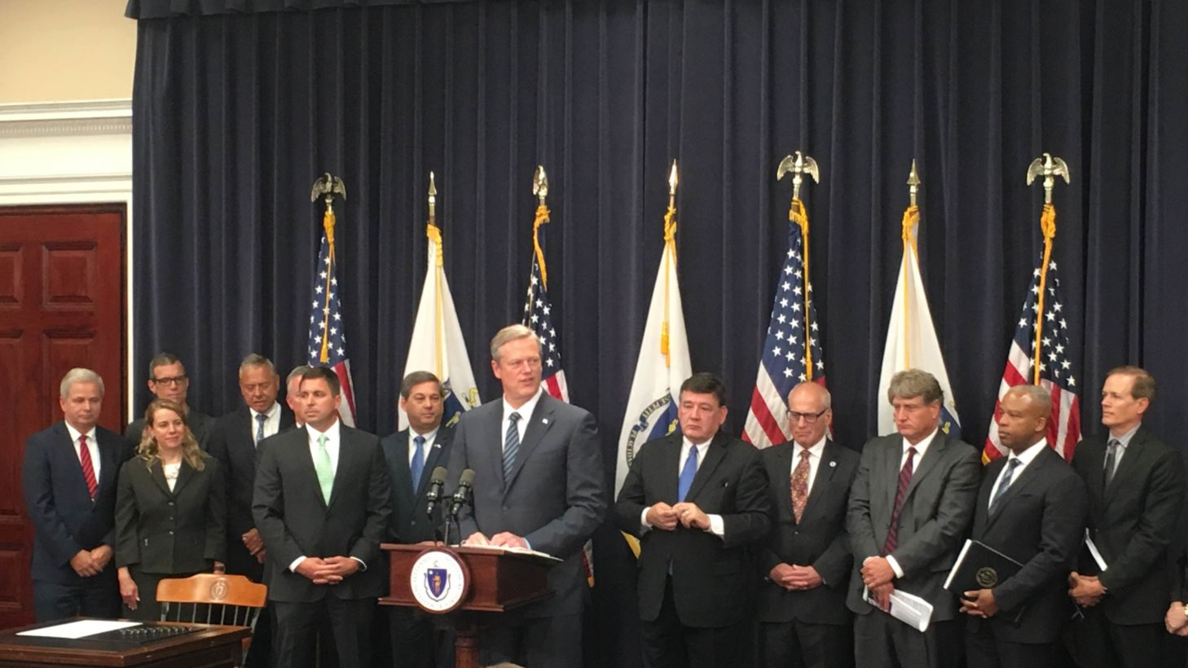
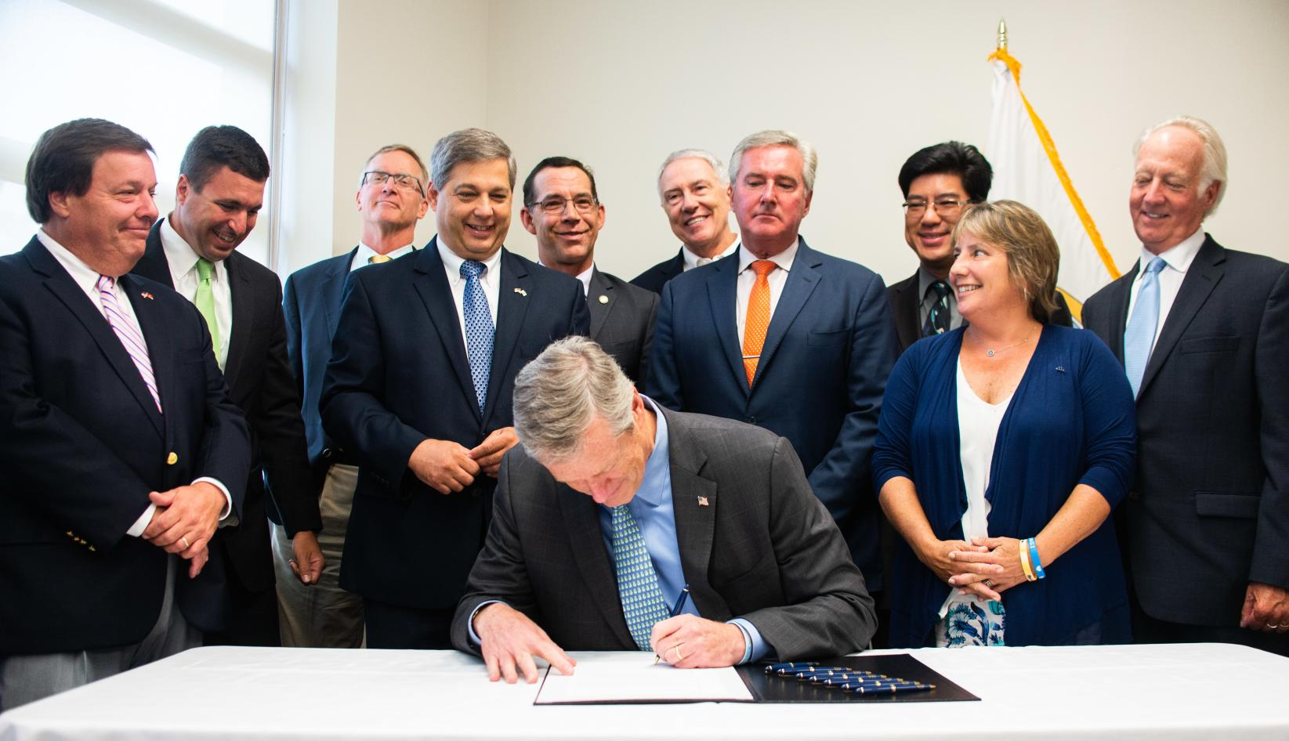
Executive Order 569 - 2016
Environmental Bond - 2018
Comprehensive approach to reduce GHG emissions to combat climate change and prepare for the impacts of climate change
State Adaptation Plan
Climate Coordinators
Agency Vulnerability Assessments
Municipal Support
$2.4 billion bond bill with focus on climate change resiliency
Over $200 million authorized for climate change adaptation
Codifies EO 569, including the MVP Program
Notes:
The Baker-Polito Administration has taken a national leadership role on climate change and has instituted important steps for the Commonwealth to lead by example.
In 2016, Governor Baker issued Executive Order 569 "Establishing an Integrated Climate Change Strategy for the Commonwealth" 569 mandated an aggressive, integrated effort using sound science to prepare state government and partner with our local communities to build climate resilience.
In 2018, Governor Baker signed an Environmental Bond Bill that codifies the commitments under the Executive Order and authorized over $2.4 billion in capital allocations for investments in preparing for climate change, including the MVP program.

Slide 3
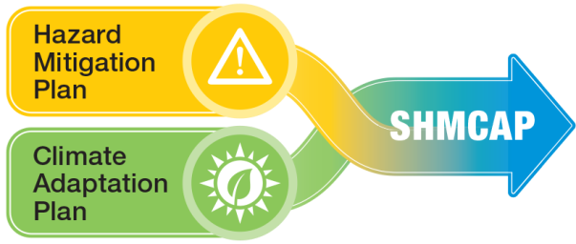
Massachusetts State Hazard Mitigation and Climate Adaptation Plan (SHMCAP) - September 2018
Acknowledges that climate change is already worsening natural hazards, integrating information and planning elements for 14 natural hazards that affect the Commonwealth
Uses best scientific data and projections to assess risk and vulnerability
Evaluates the Commonwealth’s existing capabilities to implement agency-specific and statewide activities to reduce risk and increase resilience
Notes:
The SHMCAP was a First-of-its-Kind plan, in that it integrated the state's hazard mitigation and climate adaptation planning, utilizing the most updated climate change projections for the commonwealth to do so. This is a model we encourage municipalities to emulate, in integrating their own hazard mitigation plan with the MVP planning process so that future climate conditions are incorporated into all town planning.

Slide 4
SHMCAP Key Risk Assessment Findings and Actions
14 hazards
Over $9.1M in damages/year,
2007-2014
Inland flooding
Drought
108 actions,
including:
Landslide
On average,
6 events/ year, 2009-2018
Coastal flooding
Coastal erosion
Tsunami
Develop climate change design standards
Maintain and enhance climate change projections
Incorporate climate effects into capital planning functions
Create MA Coastal Flood Risk Model
Extreme temperatures
Wildfire
Invasive species
Hurricanes/ Tropical storms
Severe winter storms / Nor’easters
200+ critical facilities in tornado hazard zones
Tornadoes
Other severe weather
Earthquakes
Notes:
The SHMCAP assessed the impacts of 14 climate hazards on the Commonwealth and resulted in 108 recommendation actions for agencies to undertake to build resilience across the state.

Slide 5
SHMCAP
SHMCAP Implementation
Leading by example
ResilientMA Action Team (RMAT)
State and local partnerships
Municipal Vulnerability Preparedness Program (MVP)
Notes:
The SHMCAP is implemented in two primary ways—through the Resilient MA Action Team, the State's interagency implementation team, and through local partnerships via the MVP grant program.

Slide 6
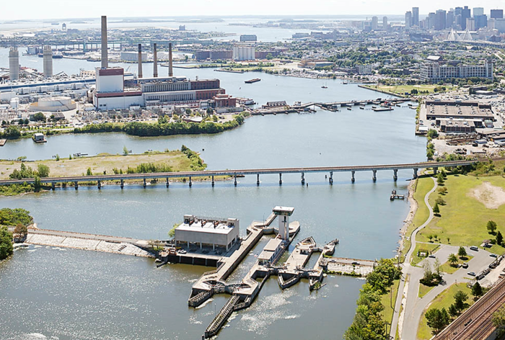
RMAT: Resilient MA Action Team
Responsible for the State Hazard Mitigation and Climate Adaptation Plan (SHMCAP) implementation, monitoring, and maintenance, with representatives from each Secretariat and key state agencies
RMAT Technical Advisor (Aug 2019-2021)
First year initiatives
Statewide resilience standards and guidance
Resilient capital planning evaluation tool
Action tracker
+ Templates for municipalities
Notes:
The Resilient MA Action Team (RMAT) is a statewide steering committee that guides implementation of the SHMCAP. It is staffed by a designated Climate Change Coordinator from each Executive Office that ensures implementation of their agency's assigned actions, and integration of the plan into their agency's daily work.
In its first year, the RMAT will be developing statewide climate resilience standards and guidance and to increase the consistency and robustness and climate change resilience review across projects, procurement, and permitting. RMAT will also be piloting a resilient capital planning evaluation tool across the statewide capital budget plan to ensure investments do not increase exposure to climate risk, and serve to build resilience across the Commonwealth. Implementation will be tracked via an online action tracker on ResilientMA.org that is currently under development.
We intend to develop templates of these tools for municipalities to utilize through the MVP program.

Slide 7
Municipal Vulnerability Preparedness (MVP) Program
A state and local partnership to build resilience to climate change by building capacity to respond to climate effects at the local level and pilot innovative adaptation practice
Across the Commonwealth, cities and towns need financial and technical resources to prepare their residents, businesses, and aging infrastructure:
300 high-hazard dams
12,000+ culverts and small bridges needing replacement
96% DHCD housing developments to see 5.4⁰ increase in max temperature by 2070
1,100 municipally-owned coastal structures
4% of all DHCD housing units in FEMA 500-year flood zone
18,800+ DHCD housing units in FEMA 100-year flood zone
Notes:
While the State prepared its own first-of-its-kind Climate Hazard Mitigation and Adaptation Plan, we knew it was equally if not more important for local municipalities to start these conversations about preparing for future climate impacts in their communities.
The need for these types of conversations, planning, and implementation of priority actions to prepare for these impacts is great
For example, there are over 12,000 culverts in MA that are undersized and/or need repair just to meet current climate conditions, let alone the increased precipitation and flooding projections of the future.
We also know there are about 300 high-hazard dams and 1,100 municipally-owned coastal structures that may need to be upgraded to withstand future sea level rise and flooding scenarios. Extreme heat will also be a problem in the future, and some of our more vulnerable populations living in areas with strong urban heat island effect and who may have less access to cooling may be particularly adversely impacted.
These are the types of conversations and assessments of vulnerabilities that the MVP program sparks in MA communities through the planning process, and then is able to fund some of the resulting priority actions through its action grant program—going beyond planning to implementation
[data on this page are from S10 testimony by SKT and Governor Baker and Ben Stone at DHCD]

Slide 8
MVP Principles
A community-led, accessible process that
Employs local knowledge and buy-in
Utilizes partnerships and leverages existing efforts
Is based in best available climate projections and data
Incorporates principles of nature-based solutions
Demonstrates pilot potential and is proactive
Reaches and responds to risks faced by EJ communities and vulnerable populations
Why nature-based?
Where appropriate, nature-based solutions can be more cost-effective, protect water quality and quantity, sustain lands that provide food and recreation opportunities, reduce erosion, and minimize temperature increases associated with developed areas and climate change.
Notes:
MVP is a community-led process that makes local knowledge-sharing and collaboration its cornerstone
By providing funds for each municipality or regional partnership to conduct its own process with its own diverse set of stakeholders, we get a plan that it tailored directly to the town and its values and has the local buy-in needed to make it implementable
MVP also values using best available climate data, and to that end hosts a clearinghouse called resilientma.org that has down-scaled climate data and projections to the county and watershed level.
MVP also focuses on nature-based solutions—or those actions strategies that rely on ecological processes to achieve climate resilience objectives like wetlands conservation, low impact development, green instead of gray infrastructure, and the like.
MVP highly values projects that reduce the risks of climate change impacts for Environmental Justice and other vulnerable populations and involves these stakeholders directly in the planning and implementation process.
The ultimate goal is to mainstream the discussion of climate change and preparing for its impacts into everyday planning and conversation in local communities

Slide 9
MVP Process/ Grant Types
MVP Planning Grant
Define and characterize hazards using latest science and data
Identify existing and future community vulnerabilities and strengths
COMMUNITY RESILIENCE BUILDING WORKSHOP(S)
MVP Action Grant
Develop and prioritize community adaptation actions
Implement priority adaptation actions identified through planning process
Determine overall priority actions
Receive MVP designation
Notes:
Planning grants are the first step in the MVP process. Communities undertake a proscribed planning process (with the help of a provider pre-trained by the state) developed by the Nature Conservancy called the Community Resilience Building process. Through this process the community assesses its vulnerabilities and strengths in the face of climate change hazards like increased precipitation and drought and identifies priority actions it would like to take to enhance its strengths and reduce its vulnerabilities.
Once the municipality successfully completes the planning process it is designated as an MVP certified community and is then eligible to apply for action grant funding to implement priority actions identified through the planning process.

Slide 10
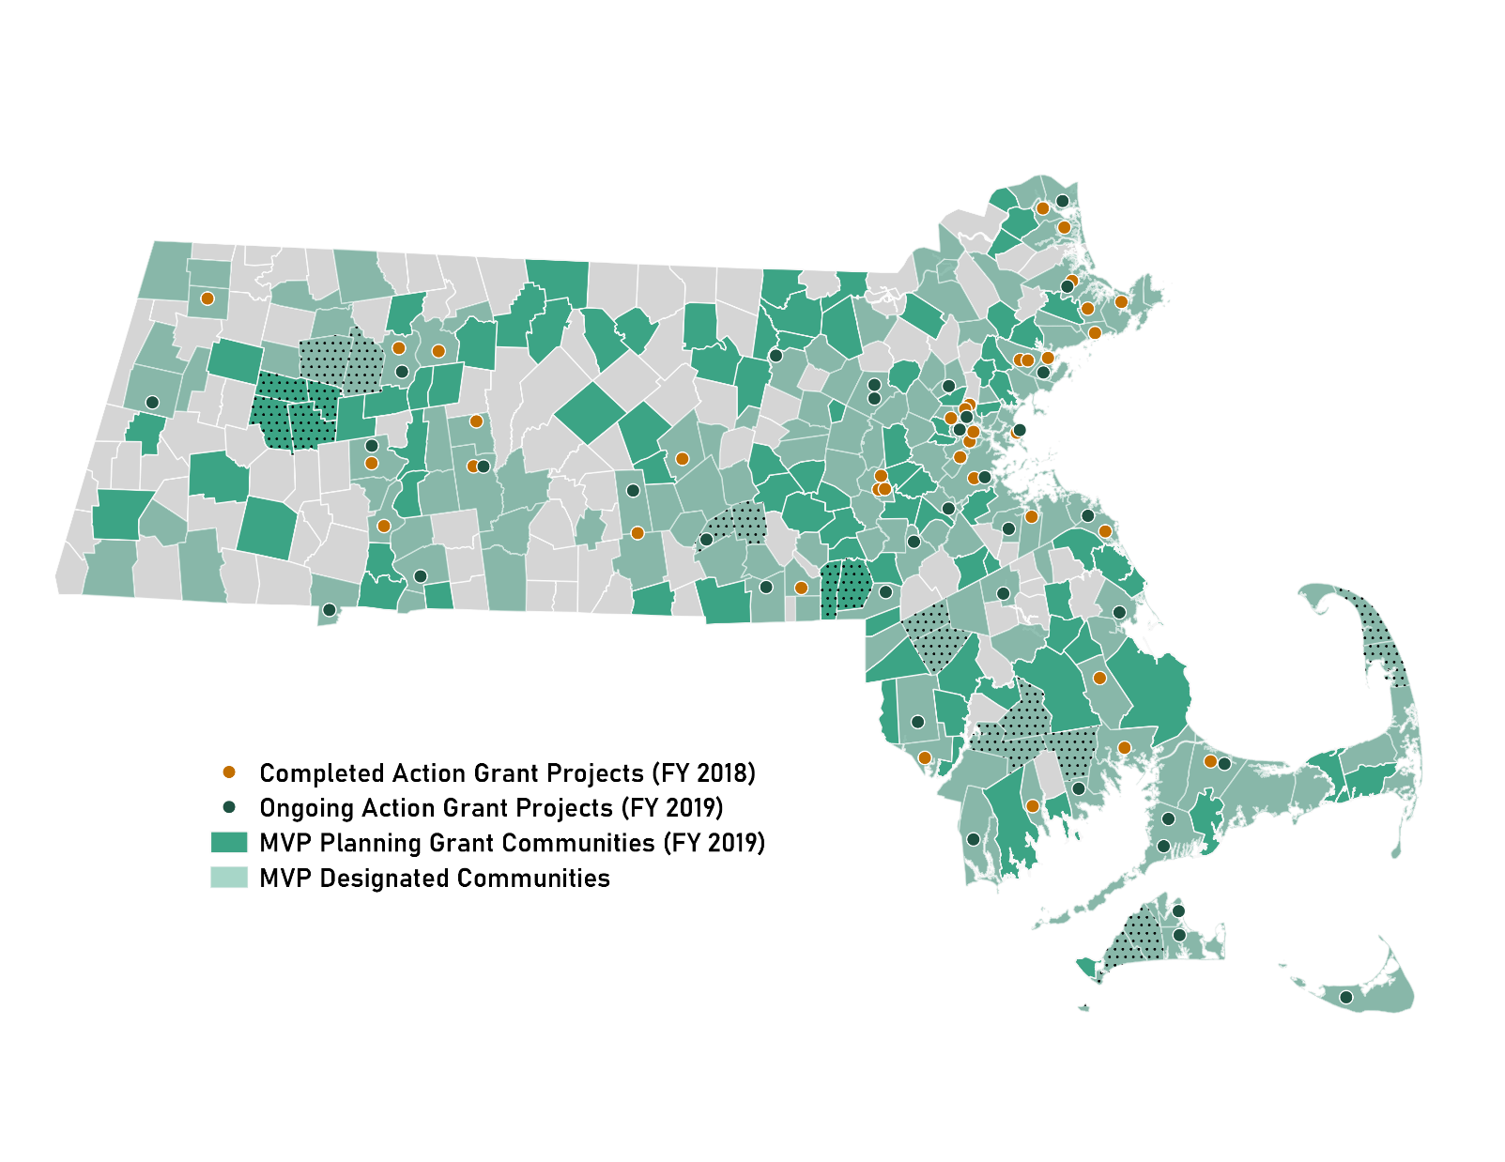
Three Years of MVP
MVP Designations 71% of the Commonwealth 249 communities
Action Grant Projects FY 18: 37
FY 19: 36
Total Awards $17M+ in planning and action grants to date
Notes:
The MVP program was established in 2017
Within the first three years of this program, 71% of the Commonwealth is participating in or has completed the MVP planning grant process.
In addition, we've seen many of these communities taking the next step in the process, by actually implementing priority projects to increase their resilience in the face of climate change impacts.
Over $17 million in planning and action grants have been awarded to date

Slide 11
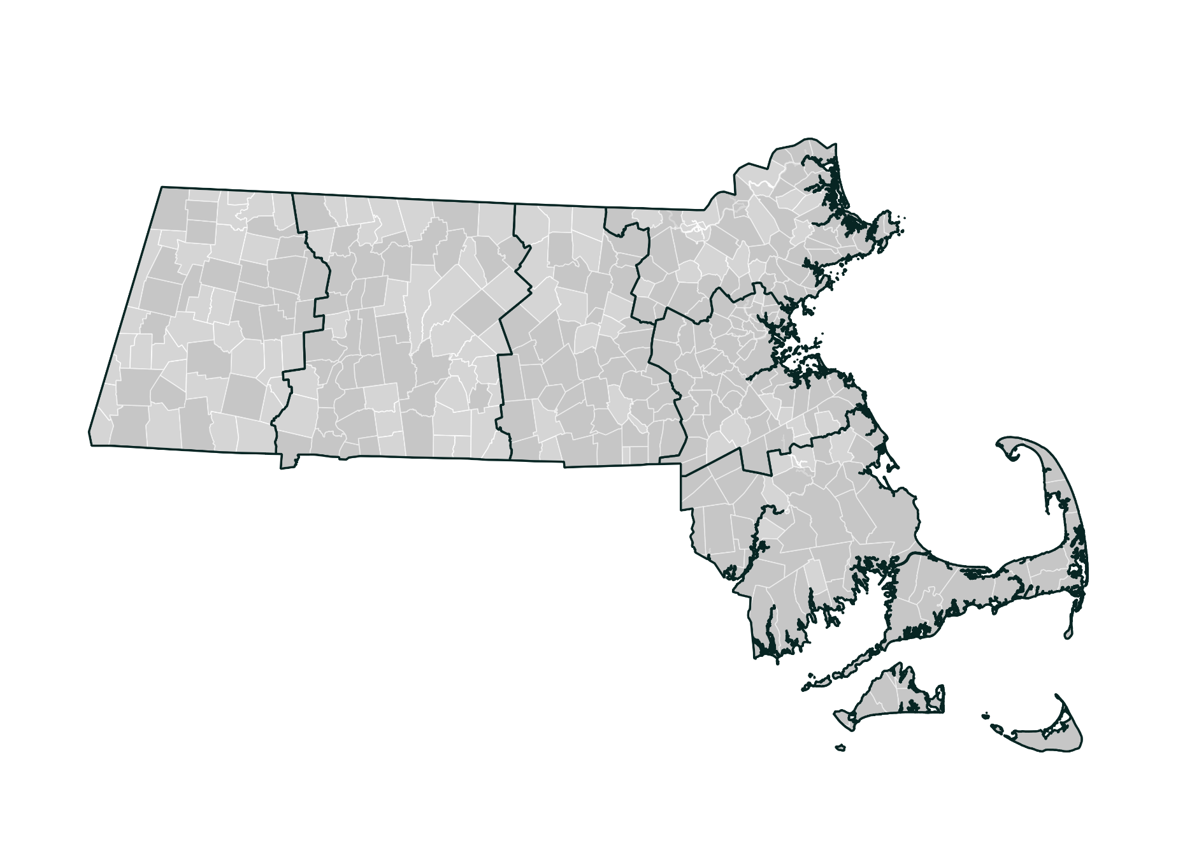
MVP Regions
Regional Coordinator:
Andrew Smith– DEP Springfield
andrew.b.smith@mass.gov
Northeast
Regional Coordinator:
Michelle Rowden – DEP Lawrence
michelle.rowden@mass.gov
Greater CT River Valley
Berkshires & Hilltowns
Greater Boston
Regional Coordinator:
Carolyn Meklenburg – EEA Boston
carolyn.meklenburg@mass.gov
Central
Regional Coordinator:
(to be filled) - Pittsfield
Regional Coordinator:
Hillary King – DEP Worcester
hillary.king@mass.gov
Southeast
Regional Coordinator:
Courtney Rocha – DEP Lakeville
courtney.rocha@mass.gov
Notes:
The MVP team is expanding! What started as a team of just a couple EEA staff is now 7 and will be 10 by the end of the year. To increase capacity to provide technical assistance and work directly with municipal staff on their projects we are hiring regional coordinators in each of 6 program regions displayed here.
These regional coordinators will help with every stage of the MVP process, from those communities that are not yet enrolled to the planning grant process, to refining priority actions into viable action grant proposals, to implementing action grants.
Your regional coordinator is your direct point of contact on the MVP program, and to connect to technical assistance across state government.

Slide 12
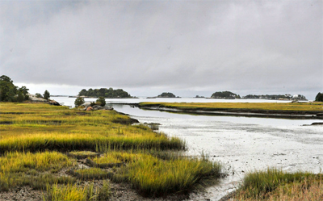
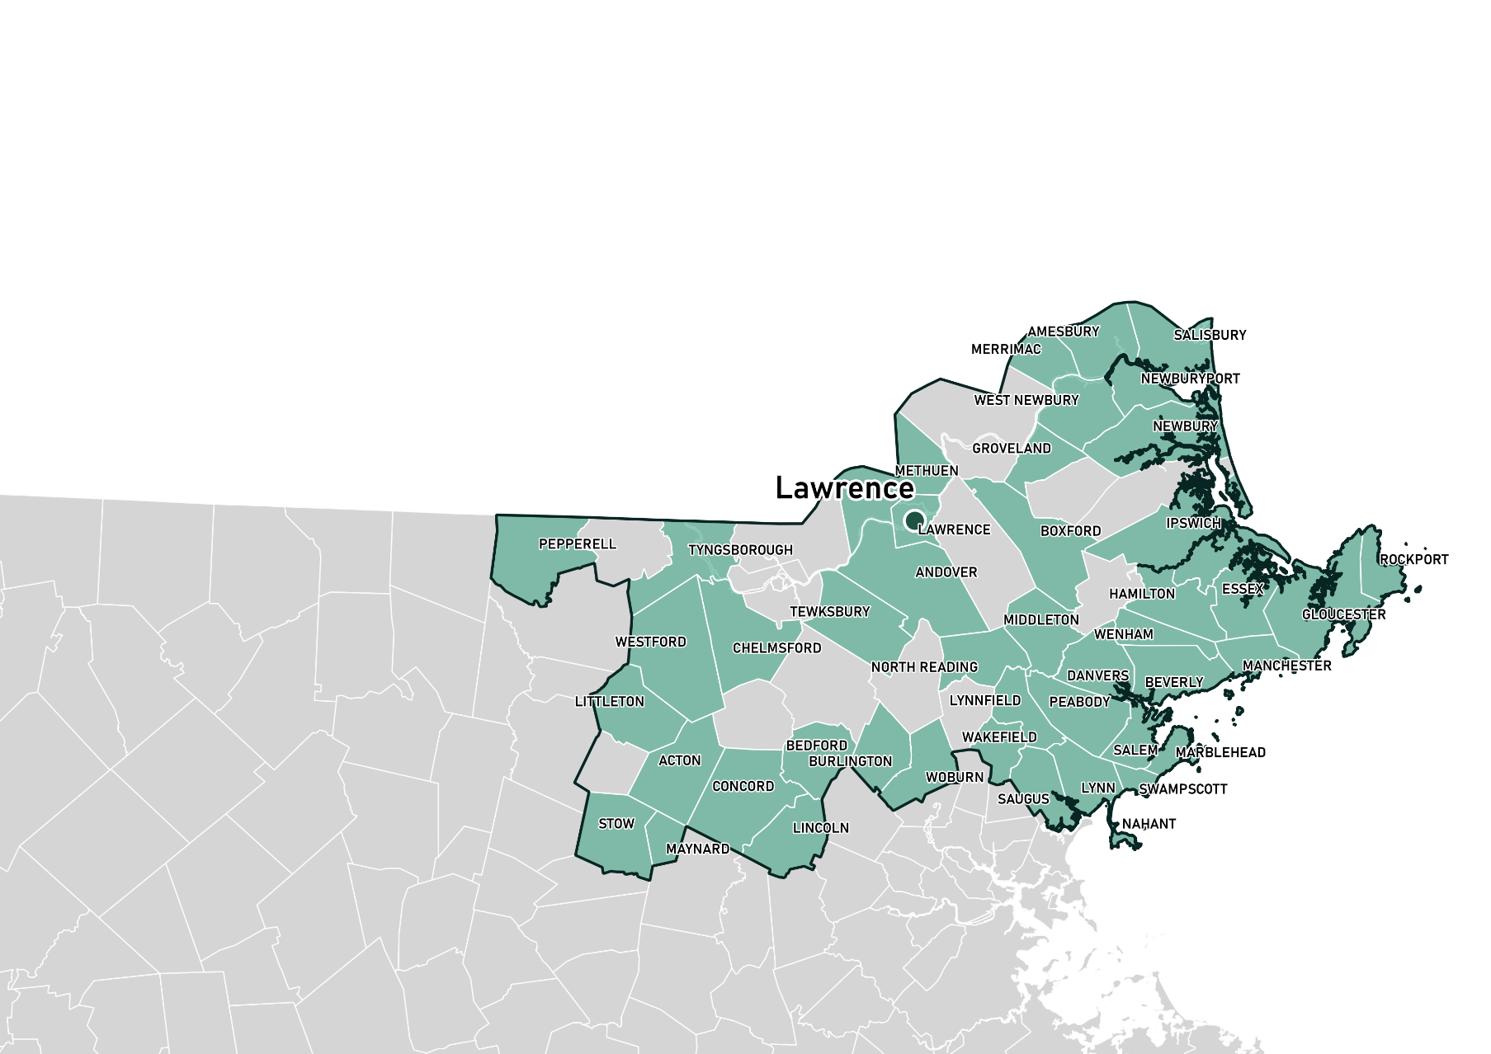
Northeast
Regional Coordinator (based in Lawrence):
Michelle Rowden - michelle.rowden@mass.gov
FY19 Planning Grants:
Bedford
Danvers
Groveland
Hamilton
Lynnfield
Maynard
Merrimac
Middleton
Pepperell
Saugus
Tewksbury
Tyngsborough
Wakefield
West Newbury
Westford
FY19 Action Grants:
Concord
Essex, Ipswich
Salem
Salisbury
Woburn

Slide 13
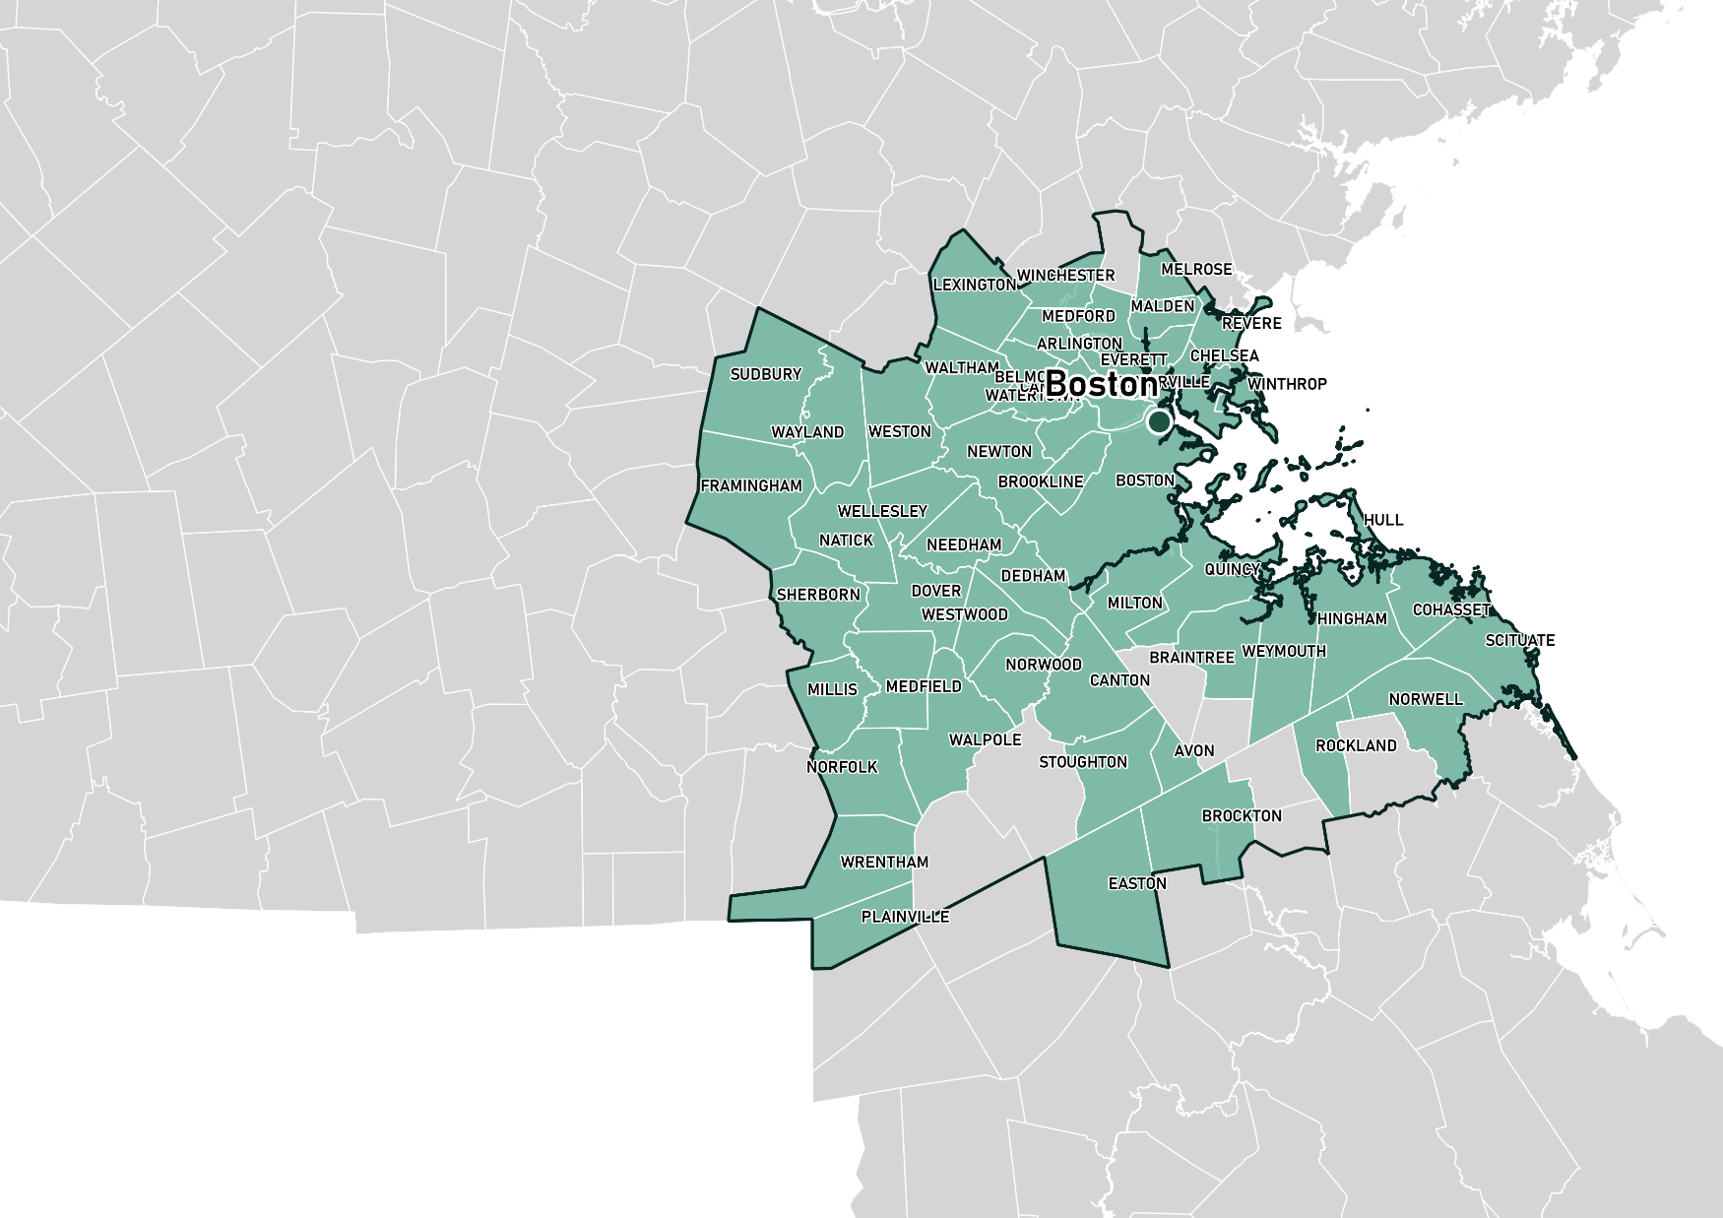
Greater Boston
Regional Coordinator (based in Boston):
Carolyn Meklenburg – carolyn.meklenburg@mass.gov
FY19 Planning Grants:
Avon
Belmont
Dover
Malden
Milton
Needham
Norfolk
Norwell
Plainville
Stoughton
Watertown
Wellesley
Weston
Westwood
Winchester
FY19 Action Grants:
Boston
Braintree
Brockton
Cambridge
Dedham
Medford
Scituate, Cohasset
Walpole
Wrentham

Slide 14
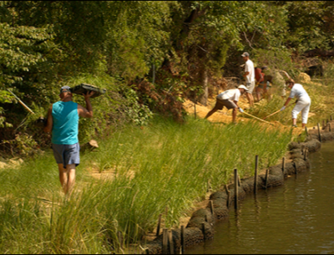
2 Types of MVP Grants
MVP Planning Grant
RFR open, rolling until mid-January
$15,000- $100,000 per plan
Some expanded scopes
$1M available
MVP Action Grant
RFR closed, next round expected Spring 2020
Open to MVP communities
$25,000- $2M per project
$10M available annually
https://www.mass.gov/municipal-vulnerability-preparedness-mvp-program
Notes:
I alluded to this in previous slides but here is a breakdown of the types of funding MVP offers.
Planning grants are smaller grants—between $15,000-$100,000 awarded to a community. That funding depends on a variety of factors including municipality size, presence of EJ communities, whether the community is asking for extra funds to do an expanded scope for additional engagement, and other factors
Planning grants consist of a proscribed process: the municipality hires a certified MVP provider, establishes a core team, holds a Community Resilience Building workshop (identifying hazards, strengths, and vulnerabilities and priority actions), drafts a final report and holds a public listening session
Once the municipality successfully completes the planning process it is designated as an MVP certified community and is then eligible to apply for action grant funding to implement priority actions identified through the planning process. Communities can apply for up to $2 million in funding or $5 million for regional projects.
We encourage regional applications for both programs to address the regional nature of climate change impacts and leverage staff capacity and expertise of multiple communities.

Slide 15
MVP Action Grants: Project Types, Findings, and Case Studies

Slide 16
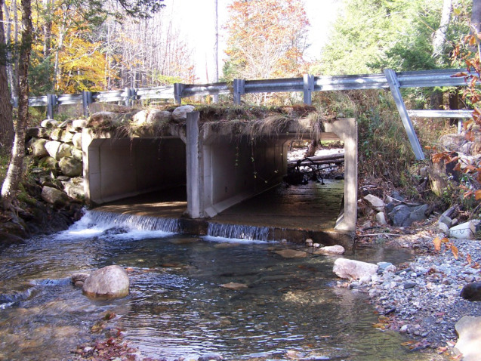
MVP Action Grants: Project Types
Detailed Vulnerability and Risk Assessment*
Community Outreach and Education
Local Bylaws, Ordinances, Plans, and Other Management Measures
Redesigns and Retrofits***
Nature-Based Flood Protection, Drought Mitigation, Water Quality, and Water Infiltration Techniques**
Nature-Based, Infrastructure and Technology Solutions to Reduce Vulnerability to Extreme Heat and Poor Air Quality
* Most common project type
** Second-most common project type
***Third-most common project type
Notes:
MVP action grants take many forms and we have many different types of projects we fund. The most common types from our first two rounds of this program were more detailed vulnerability and risk assessments, nature-based flood protection projects, and redesigns and retrofits.
It is critical that action grants demonstrate how they are utilizing climate change data to build local resilience to future, changing conditions, and advancing priority actions from the MVP plan.

Slide 17
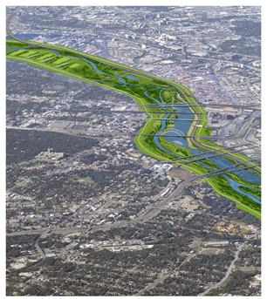
MVP Action Grants: Project Types (cont.)
Nature-Based Solutions to Reduce Vulnerability to other Climate Change Impacts
Ecological Restoration and Habitat Management to Increase Resiliency
NEW IN 2019
Energy Resilience
Chemical Safety
Land Acquisition for Resilience
Subsidized Low-Income Housing Resilience Strategies
Mosquito Control Districts
+ Expanded eligibility of project location
Notes:
Some new project types in 2019 include:
Energy resilience: incorporate clean energy and be paired with resilience enabling technologies such as energy storage, energy management systems, blackstart and islanding technology, and microgrids
Chemical safety: engage the business and manufacturing community on identifying vulnerabilities to chemical releases due to severe weather events,
Land acquisition for resilience
We also expect to a project type in our next round that will encourage projects that focus on building resilience in subsidized low-income housing developments
In the last round we expanded the eligibility of project location- can conduct a project on privately-owned land if supported by landowner.

Slide 18
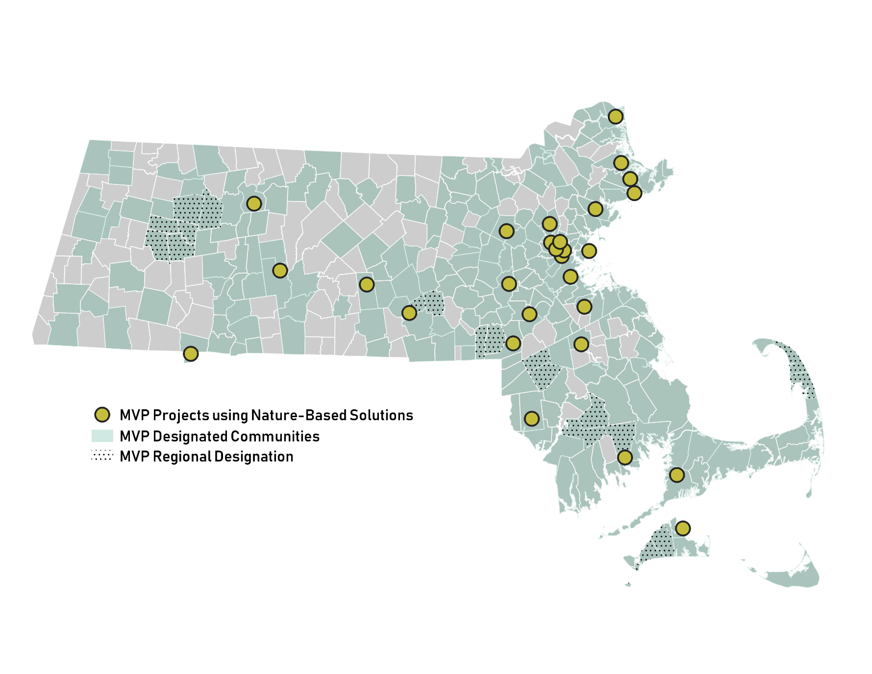
Nature-Based Solutions
Essex, Ipswich, Newbury (Regional)
Sedimentation study
Concord
Reforestation and municipal tree resilience
Southwick
Stream crossing replacement with upstream nature-based flood mitigation measures
Millbury
Green infrastructure in downtown revitalization
Northampton
Detaining, retaining, treating stormwater with green infrastructure
Falmouth
River restoration
Oak Bluffs
Beach nourishment
MVP Planning Grant/Designated Communities (2017-2019)
Notes:
As I mentioned before, nature-based solutions are a cornerstone of the MVP program. We have funded different types of nature-based solutions all throughout the sate, some of which are displayed here.

Slide 19
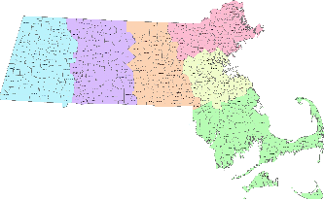
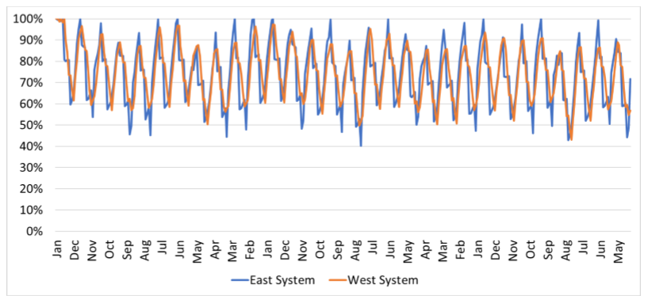
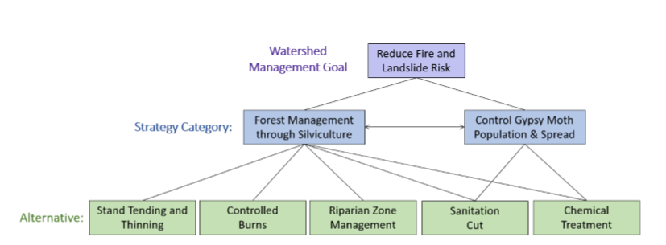
FY18 Action Grant Project
Watershed and Water Supply Vulnerability, Risk Assessment and Management Strategy
Vulnerability Assessment and Analysis
Gloucester
Project Objectives:
Identify potential climate change related risks to the watershed and water supply system
Assessment and analysis of alternative management strategies for the city’s water supply and reservoir system, including watersheds
Develop recommendations for management and infrastructure strategies to mitigate for identified risks to water supply reliability
MVP Grant: $107,044
Match Amount: $35,726
Total Project Cost: $138,802
Diagram of Land Management Alternatives to Reduce Risk of Fire and Landslide
Total Supply Available with Operational Changes Implemented

Slide 20
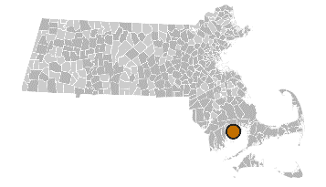
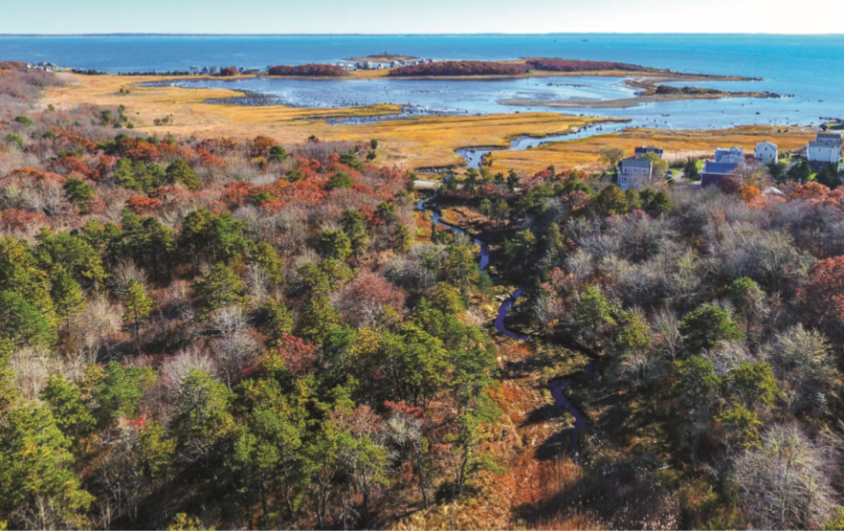
Example Action Grant Projects
Land Acquisition for Resilience
Mattapoisett
Purchasing 120 acres of forest, streams, freshwater wetlands and coastal salt marsh as conservation land to prevent development in vulnerable areas
Data utilization
Proactive
Notes:
Here are a few examples of action grants currently underway that illustrate some important principles of the MVP program.

Slide 21
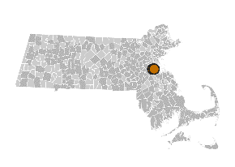
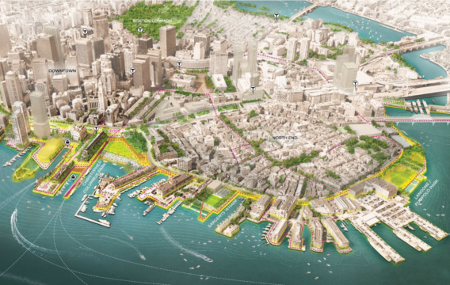
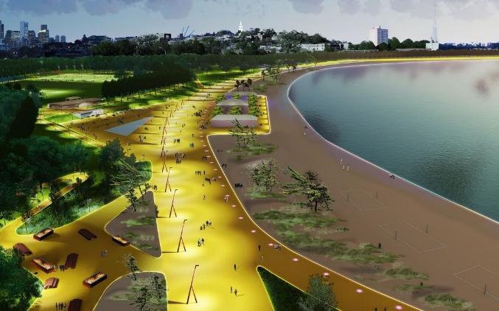
Example Action Grant Projects
Local Bylaws, Ordinances, Plans, and Other Management Measures
Redesigns and Retrofits
Boston
Developing its first ever resilient building code so that development in the future floodplain is prepared for at least three feet of sea level rise, the likely scenario by late century.
Retrofitting a major waterfront park into a legacy park that uses nature-based solutions to address climate vulnerabilities while providing important access to recreation for residents.
Proactive
Nature-based solutions
Pilot potential
Community co-benefits
Notes:
Major waterfront park = Moakley Park in South Boston
MVP funds are for technical feasibility, resilient design plans, and pre-permitting assessment
*Good example of phasing—this MVP project will allow them to start construction next year

Slide 22
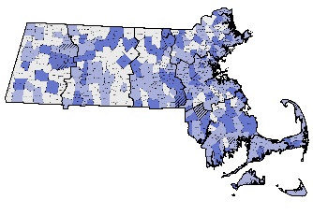
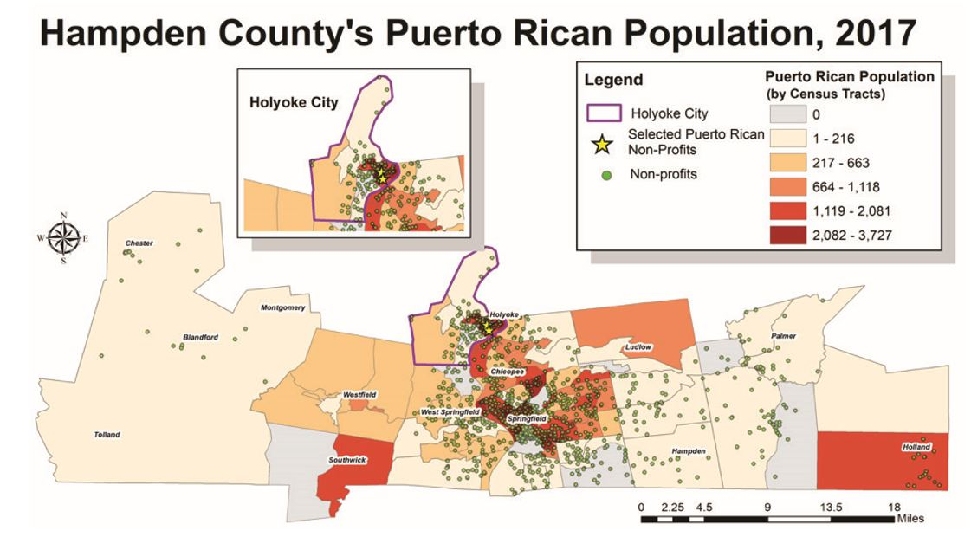
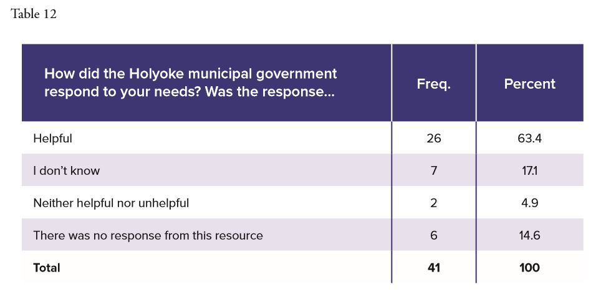
FY18 Action Grant Projects
Detailed Vulnerability and Risk Assessment, Further Planning
Holyoke
Conducted a detailed demographic analysis of individuals who arrived in Holyoke from Puerto Rico as a result of Hurricane Maria and develop recommendations for planning for future climate change migrants in Holyoke
Informational graphics from Holyoke's final report
Image credits: Town of Holyoke, Hunter College CUNY, El Instituto UCONN
Notes:
Assessed the ways in which Holyoke handled this influx of climate migrants, and proposed recommendations for how they could better receive more climate migrants in the future, since Holyoke has a strong Puerto Rican community

Slide 23
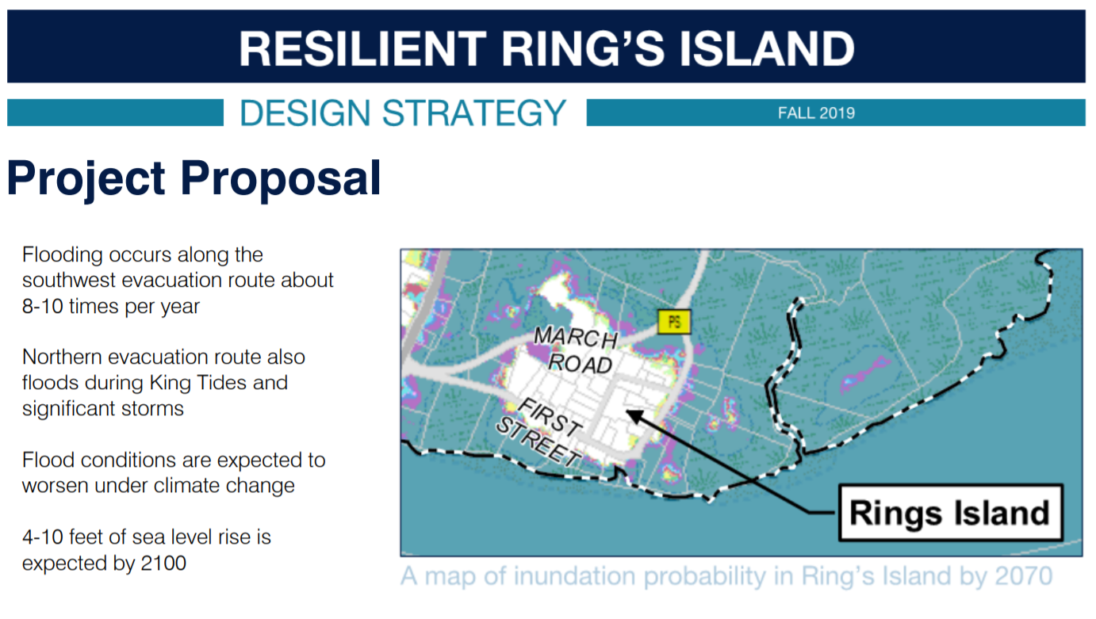
MVP in Action: Resilient Ring’s Island: Preventing a Neighborhood from Being Stranded by Flooding
Salisbury Town Planner: Lisa Pearson

Slide 24
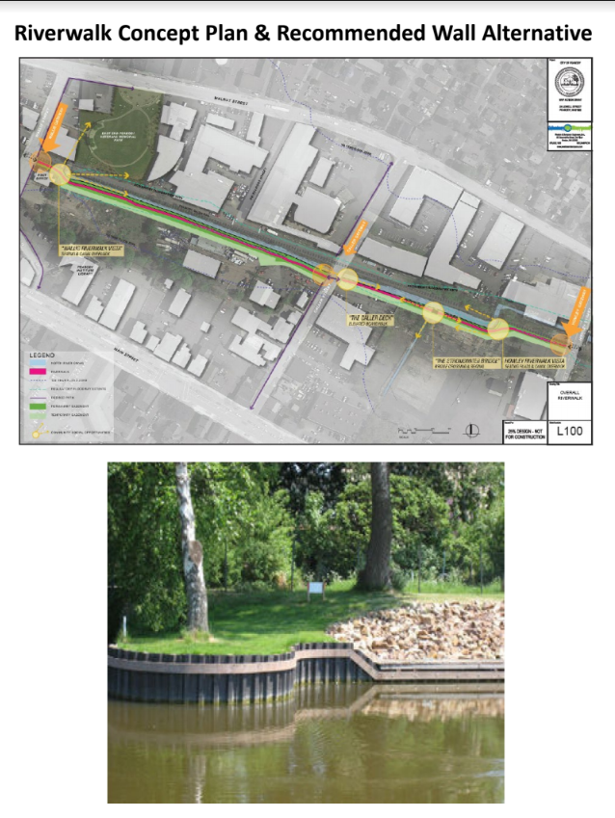
MVP in Action: The Riverwalk
Peabody Town Planner: Brendan Callahan

Slide 25
MVP in Action:
Feasibility Study for An Essex Bay Living Shoreline
Essex Town Administrator: Brendhan Zubricki

Slide 26
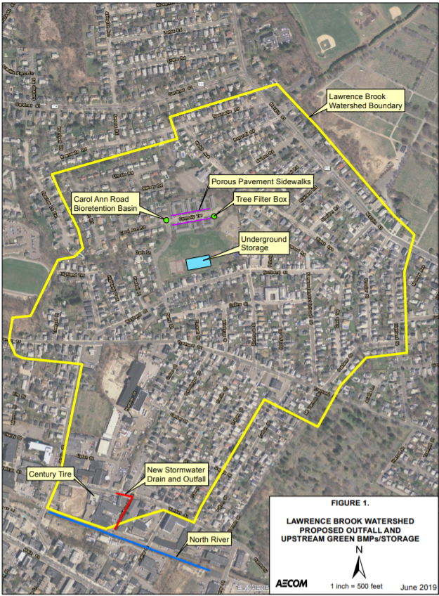
MVP in Action:
Lawrence Brook Watershed
Town Planner:
Brendan Callahan

Slide 27
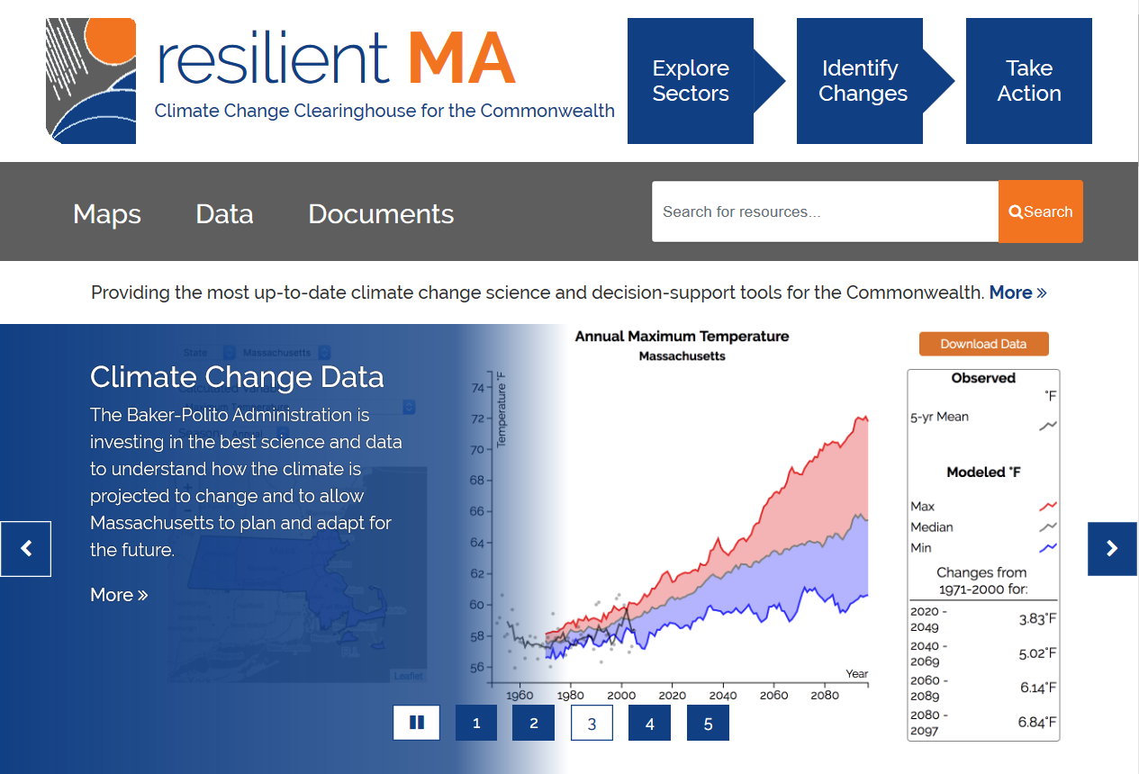
resilientMA
Climate Change Clearinghouse
Most up-to-date climate science and decision-support tools
MVP Resources
https://www.mass.go/municipal-vulnerability-preparedness-mvp-program
Notes:
I mentioned before that MVP values using best available climate data, and to that end hosts a clearinghouse called resilientma.org that has down-scaled climate data and projections to the county and watershed level and other great resources and information about climate change hazards and impacts in MA

Slide 28
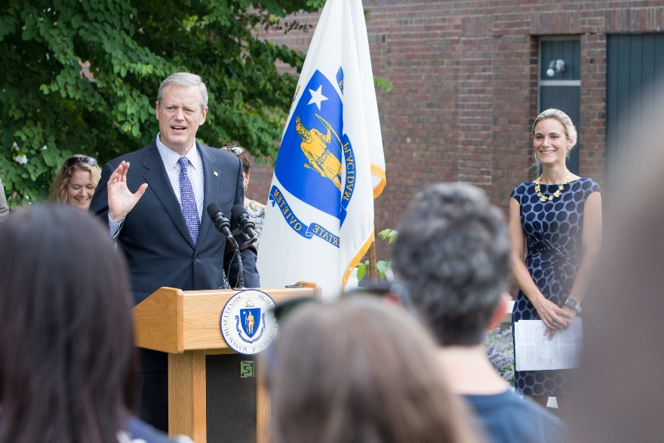
Next Steps: Climate Change & the Commonwealth
Bill S.10:
An Act for Climate Change Adaptation Infrastructure Investments in the Commonwealth
Building on success of existing programs like MVP: Proposed new source of revenue for loans, grants, and technical assistance to municipalities and regional partnerships for priority adaptation projects
Proposed deeds excise increase → est. $137M annually ($1B in ten years)
Recurring, long-term revenue stream for multi-year project feasibility
Notes:
We also wanted to note the importance of a current bill in front of the legislature to create a new, sustainable source of revenue to support climate change resilience implementation across the Commonwealth. Governor Baker filed Senate Bill 10, An Act for Climate Change Adaptation Infrastructure Investments in the Commonwealth, that will dedicate an estimated $137million a year to the Global Warming Solutions Trust Fund through an increase in the deeds excise, a fee on the sale of property. This funding would be a source of loans, grants, and technical assistance to municipalities, regional partnerships, and agencies to implement climate adaptation and resilience infrastructure projects with broad community benefits.

Slide 29
MA 2050 Decarbonization Plan
EEA is conducting an 80x50 Study to identify the strategies, policies, and implementation pathways for MA to achieve at least 80% Greenhouse Gas reductions by 2050.
The results of that research will be published in a 2050 Roadmap report and will inform the setting of a 2030 GHG emissions limit and the development of the Clean Energy and Climate Plan for 2030.
More information and opportunities to get involved:
www.mass.gov/2050Roadmap
Notes:
I also wanted to quickly mention another effort going on by EEA at the state-level around mitigation. [Read Slide]

Slide 30
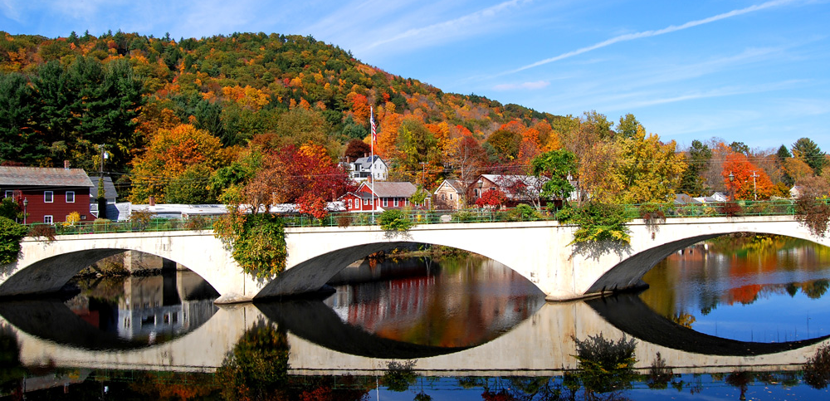
Michelle.Rowden@Mass.gov
Carolyn.Meklenburg@Mass.gov
https://www.mass.gov/municipal-vulnerability-preparedness-program
https://www.mass.gov/municipal-vulnerability-preparedness-program
Notes:
Thank you all for your attention today. I'd be happy to take any questions now, or please reach out over email.

