Slide 1
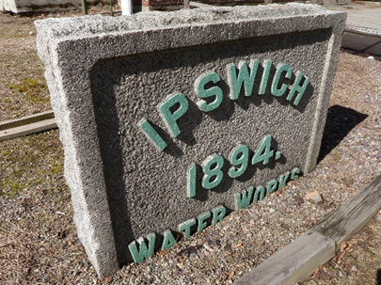
Water Neutral Growth in the Town of Ipswich Integrating Land Use Planning and Water Conservation Strategies to Build Climate Resiliency for the Future
PIE-Rivers Partnership Annual Meeting
December 5, 2019

Slide 2
Town of Ipswich Water sources
Parker river watershed
Browns, mile lane wells
Dow & Bull brook reservoirs
Ipswich river watershed
Essex road, fellows road & Winthrop WEll

Slide 3
Current challenges
Source restrictions (Manganese, infrastructure age)
Regulatory (emerging contaminants) and Sustainable Water Management Initiative (SWMI)
Drought vulnerability (2016 Drought)
Land use changes/development pressures (more impervious surface, water quality impacts, increased water demand)
Climate change
…. have led to a Community discussion of water needs, climate impacts, and resiliency
Notes:
Ipswich river sources capped at existing (safe yield) and parker river sources subject to SWMI - Basically there’s no more water available and summer use needs to go down

Slide 4
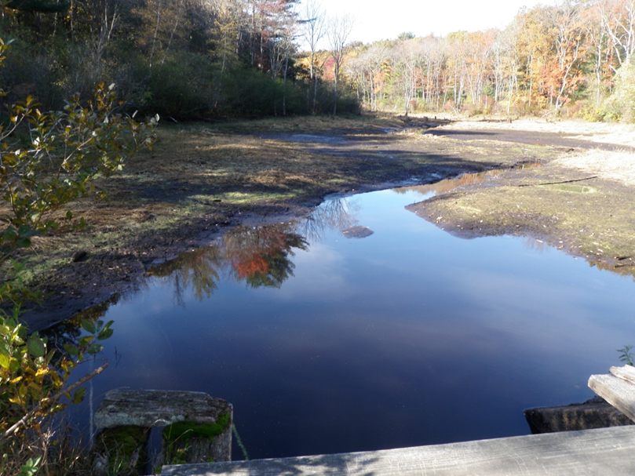
What Happened in 2016?
Significantly Below average precipitation
High customer water demand
Reduced capacity Browns & Fellows Road Wells – manganese (MN)
Required emergency declaration by dep
Dry River bed (environmental and recreational impacts)
Community response
Regulation updates
Water restriction by-law
including private wells
Heightened concern about water
Bull Brook Reservoir
2016
Notes:
Maybe not as much detail on this slide?

Slide 5
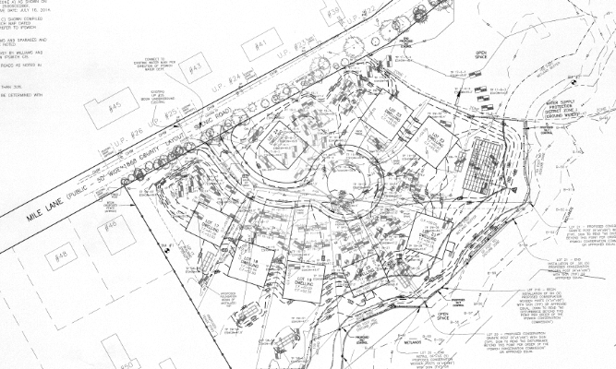
Land use & development
Increasing concern over development impacts inside and outside of water supply protection zones
expansion of impervious surfaces
Water quality
Recharge
erosion
Increased water demand

Slide 6
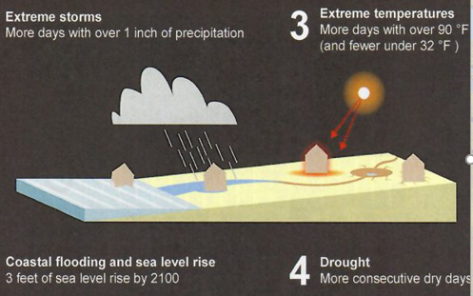
Climate Change: Expected changes/impacts
Extreme weather
Power, equipment failures, facility damage
More droughts/greater magnitude
Strains ability to meet demand
Threatens natural water cycle
More frequent & heavy rainfall
Flooding, Erosion
Sediment accumulation
Sea level rise
Potential salt water intrusion

Slide 7
Existing initiatives
Water supply protection
By-Law
2,000 acres surface & groundwater protection zones
Demand management
Monthly billing
Smart Meters
Residential Seasonal Rate Structure
15% drop in total annual water use
24% drop in summer residential water use
Drought Management Plan
Water Restriction By-law
Education through Greenscapes North Shore Coalition

Slide 8
Still need to Reduce vulnerability & build resiliency
Build redundancy, reliability, resiliency
Infrastructure improvements
Water Supply Protection
Water Demand management
Education & Outreach
Basis for MAPC Grant Project with Ipswich River Watershed Association
Water Neutral Growth Project Goal:
Reduce existing water use to the maximum extent possible, especially during periods of lower water availability, and minimize additional demand created by future growth and development
Notes:
Maybe not as much detail on this slide?

Slide 9
Water neutral growth grant project Recommendations: minimization & offsets
Land Use: water use minimization through water neutral growth bylaws, low impact development & stormwater regulations, and incentives
Water Bank/In Lieu Fee programs: recommendations for water use mitigation programs (aka “WUMP”)
enhanced water Conservation Strategies: completing a water Use Profile analysis to drive recommendations & strategies
Notes:
What we’ve done over the year

Slide 10
Land Use Recommendations
Establish a clear permit review process that considers water use for all new and redevelopment projects
Review current bylaws using tools such as Mass Audubon’s Tool for Low Impact Development & Climate-Smart, Nature-Based Solutions
Adopt a Water Neutral Growth Bylaw that requires developments to achieve “net zero” water use through minimization and offsets
www.massaudubon.org/our-conservation-work/advocacy/shaping-the-future-of-your-community/saving-land-water-money-with-lid
Notes:
1. Town should establish permit review process to effectively implement adopted water savings recommendations for all new and re-development projects
2. Ipswich should adopt a Water Neutral Growth Ordinance that requires developments achieve net zero through minimization and offsetting their projected additional water demand. Incentive use of grey water and rainwater re-use as a central component.
3. Ipswich should undertake a thorough review of its development by-laws to minimize water use - bylaws (including for building permits exempt from planning/zoning review) should mandate maximum implementation of LID-related requirements and make OSRD the norm for subdivisions

Slide 11
Stormwater Solutions
Treat rainwater as a resource not a waste product or problem
Using GIS, identify best sites for maximizing infiltration of stormwater through green infrastructure and/or a drought resilience zoning overlay district
Update stormwater bylaw to prohibit the discharge of stormwater runoff to the maximum extent feasible from every parcel (100% infiltration)
Meet the requirements of the epa ms4 permit
Notes:
- Using GIS, identify best sites for maximizing infiltration of stormwater through green infrastructure and/or a drought resilience zoning overlay district
- Update stormwater bylaw to prohibit the discharge of stormwater runoff to the maximum extent feasible from every parcel (100% infiltration)
- Meet the requirements of the epa ms4 permit

Slide 12
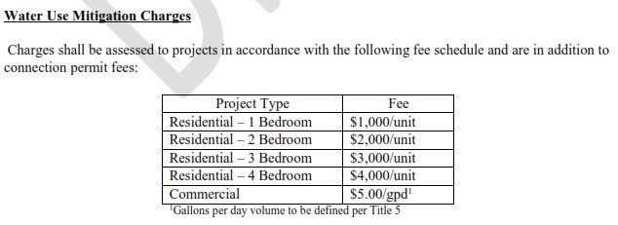
Water Use Mitigation Recommendations Water Bank – In Lieu Fee Programs
Water use mitigation mechanisms can reduce or eliminate the strain of new development on the community’s water system
Notes:
Ipswich watershed neighbors Danvers and Wenham currently have water use mitigation programs. Describe recommended WUMP for Ipswich.

Slide 13
Ipswich Draft “WUMP”
Back of the envelope calculations….
Residential Development Projects Approved by Planning Board* 2015 – 2019
* Need to capture development that does not go through Planning Board permitting
7 Projects, Totaling 80 Bedrooms
Estimated WUMP Revenue (residential): $80,000 over the 5 years
Funds to support additional conservation efforts
Water audits, rebates, retrofits, educational programming, etc.
Notes:
Commercial not calculated, what are the complications –
Focus more on mitigation than fee collection
Describe residential calculations
$80,000 over 5 years – could fund enhanced water conservation programs
Explain commercial questions ….

Slide 14
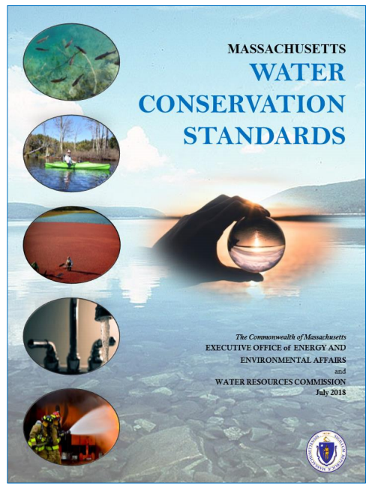
Enhanced Water Conservation Strategies
Analysis of the Town’s individualized water use patterns to inform customer-specific conservation strategies
Water Loss Control review - American Water Works Association (AWWA) M36 “Top-Down” Audit
Adoption of recommendations from the recently completed Massachusetts Water Conservation Standards (July 2018)
www.mass.gov/massachusetts-water-conservation-standards
Notes:
Highlights of the analysis include:
- Single family residential uses about 60% of the water in town and use increases by about 25% in the summer. The top 10% of summer water users use ~30% of summer residential water.
Commercial users are the 2nd largest water use group and use about 20% of water in town and use increases by about 25% in summer. Most commercial users don’t increase water use in summer; the increase in water use is due to ~10% of the accounts.
Minimize real and apparent losses by meeting or demonstrating steady progress towards an unaccounted-for-water (UAW) percentage of 10% or less
Enhanced water conservation measures give examples including community-based social marketing toolkit

Slide 15
Town of Ipswich Water Use Data Analysis MA Division of Ecological restoration – 11/20/19
Data disclaimers:
All data presented is an average of 2017 and 2018
Summer use is defined as May-September
Winter use is defined as November-March
Discretionary use is calculated by subtracting total winter use from total summer use

Slide 18
Water Use Profile Analysis Drives Water Conservation Strategies
Results Point Town Focus Toward:
Specific Commercial Customers
Audits
Education
Regional Residential Customers
Rebates
Education – including MA DER/DEP Community-based Social marketing
Notes:
Land use regulations and development patterns in the Ipswich Basin communities are impacting water availability. Recommendations aimed at “water-neutral growth” include: adoption of a new ordinance to require developments to offset their projected additional water demand; review of bylaws to find opportunities to require and/or incentivize low impact development practices and green infrastructure; and recommended conditions for water use minimization which are available to permitting boards and committees. All of these tools will enable the community to work towards water neutral growth.
Water use mitigation mechanisms can reduce or eliminate the strain of new development on the community’s water system. A few other Massachusetts towns (including Ipswich watershed neighbors Danvers and Wenham) currently have water use mitigation programs. This report summarizes the lessons learned by these communities and the benefits to Ipswich in adopting this tool, and sets forth a recommended WUMP for Ipswich.
While gains have been made toward reducing water use across the Ipswich watershed over recent decades, there is more that can be done, especially in the summer when water use is the highest, there is the least amount of water available, and the threat of drought is highest. An analysis of the Town’s individualized water use patterns developed a water use profile which can inform customer-specific conservation strategies. Enhanced water conservation practices for Ipswich include: adoption of recommendations from the recently completed 2018 Massachusetts Water Conservation Standards, community-based social marketing practices promulgated by the MA Department of Environmental Protection and the Division of Ecological Restoration, and other new technological tools.

Slide 19
Water Conservation Strategies
Address summer irrigation: prohibit automatic sprinklers or require rain sensors; consider irrigation sub-metering and billing (higher fees for irrigation); education
Indoor water audits: rebates, assistance, leak repair (businesses as well as residential)
Outdoor water audits: educate about water-wise landscapes; rebates for removal of high-water-use plants and sod and replacement with less water-intensive vegetation
Seasonal limits & restrictions: on watering within 48 hours of measurable rainfall; washing of hard surfaces (sidewalks, patios, driveways, siding); personal car washing; operation of non-circulating fountains; filling of swimming pools
Municipal buildings: audit Town Hall and all town buildings and properties for indoor and outdoor water efficiencies, with educational signage
Business audits: opportunities to work with commercial users including agricultural and recreational related businesses whose summer use is high
Notes:
Land use regulations and development patterns in the Ipswich Basin communities are impacting water availability. Recommendations aimed at “water-neutral growth” include: adoption of a new ordinance to require developments to offset their projected additional water demand; review of bylaws to find opportunities to require and/or incentivize low impact development practices and green infrastructure; and recommended conditions for water use minimization which are available to permitting boards and committees. All of these tools will enable the community to work towards water neutral growth.
Water use mitigation mechanisms can reduce or eliminate the strain of new development on the community’s water system. A few other Massachusetts towns (including Ipswich watershed neighbors Danvers and Wenham) currently have water use mitigation programs. This report summarizes the lessons learned by these communities and the benefits to Ipswich in adopting this tool, and sets forth a recommended WUMP for Ipswich.
While gains have been made toward reducing water use across the Ipswich watershed over recent decades, there is more that can be done, especially in the summer when water use is the highest, there is the least amount of water available, and the threat of drought is highest. An analysis of the Town’s individualized water use patterns developed a water use profile which can inform customer-specific conservation strategies. Enhanced water conservation practices for Ipswich include: adoption of recommendations from the recently completed 2018 Massachusetts Water Conservation Standards, community-based social marketing practices promulgated by the MA Department of Environmental Protection and the Division of Ecological Restoration, and other new technological tools.

