Slide 1
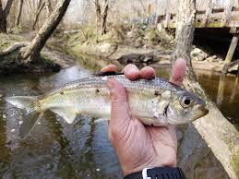
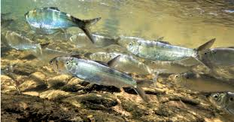

Howlett Brook Restoration Project
Kaitlyn Shaw, Ipswich River Watershed Association
Colin Lawson & Joel DeStasio, Trout Unlimited National

Slide 2
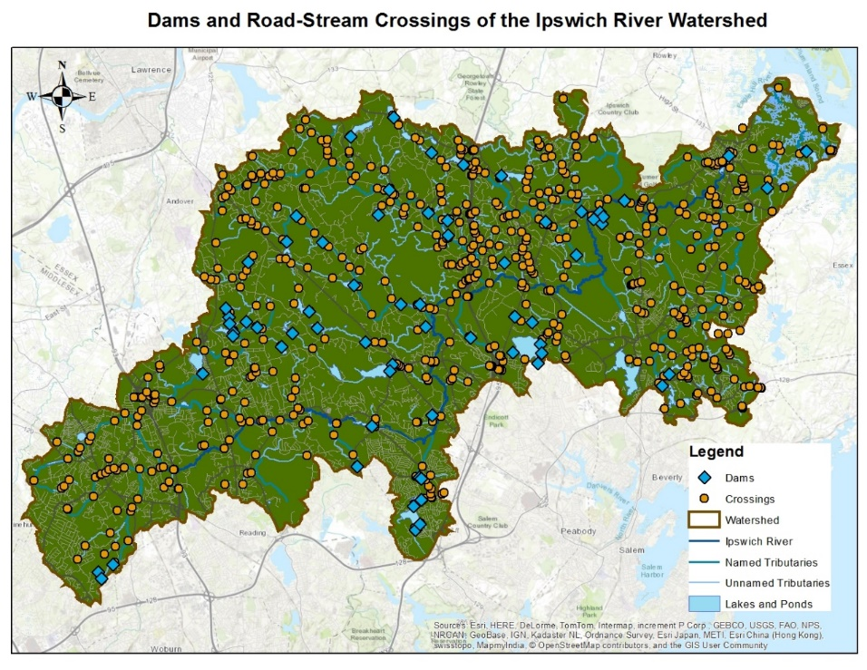
Restore Coldwater and Diadromous Fish Habitat in Howlett Brook Watershed (MA)
Great Marsh Barriers Assessment
Survey and systematically prioritize dams, stream crossings and tidal restrictions
Prioritize based on infrastructure/public safety risk AND ecological impact
Intended as a tool to help towns and other entities set repair/upgrade schedules within limited budgets
Funding: National Fish and Wildlife Foundation – Hurricane Sandy Sandy Coastal Resiliency Grant

Slide 3
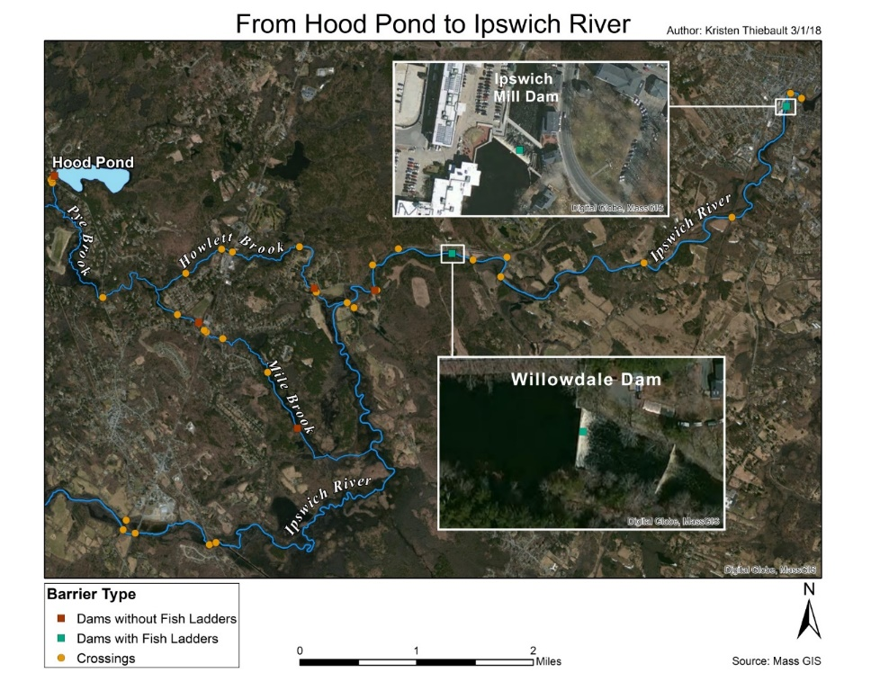
Restore Coldwater and Diadromous Fish Habitat in Howlett Brook Watershed (MA)
Funding
National Fish and Wildlife Foundation, Forest and Rivers Fund (received)
Division of Ecological Restoration Culvert Replacement Municipal Assistance (sought)
Division of Marine Fisheries- Technical Assistance
Municipal Vulnerability Preparedness Action Grant- upgrade culvert design plans (sought)

Slide 4
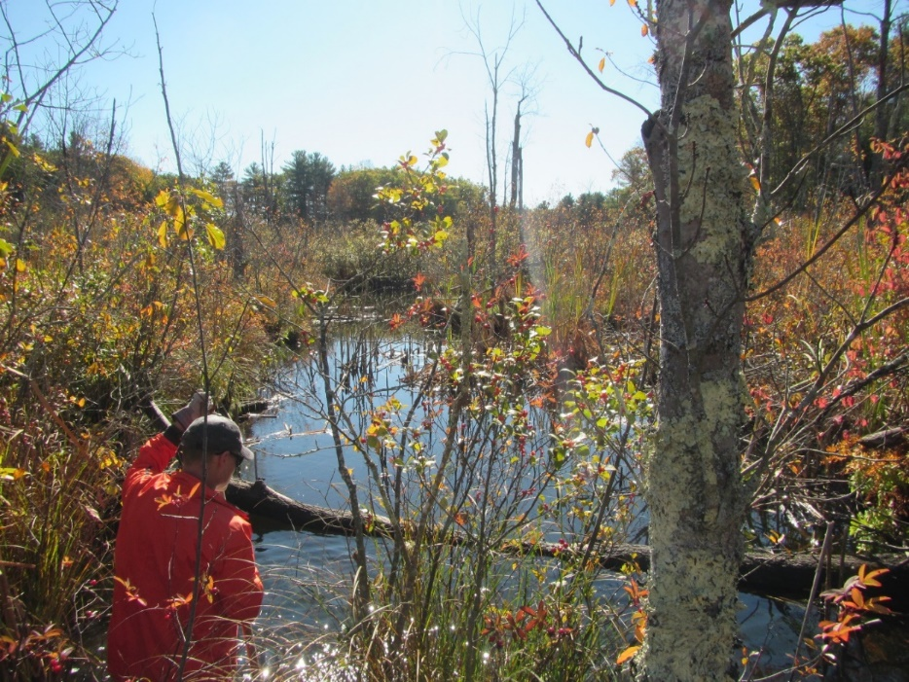
Restore Coldwater and Diadromous Fish Habitat in Howlett Brook Watershed (MA)
Implement Steam Maintenance Plan, as approved by Topsfield (Trout Unlimited Nor’East and Ipswich River Watershed)

Slide 5
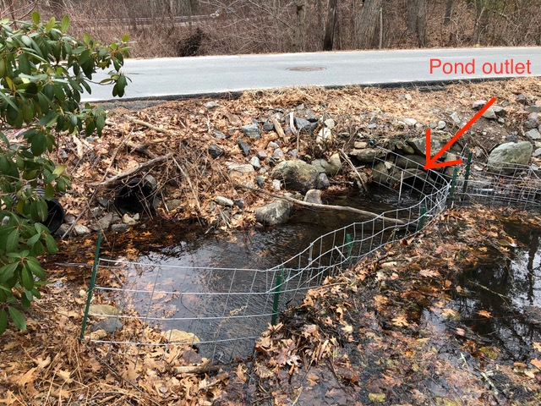
Restore Coldwater and Diadromous Fish Habitat in Howlett Brook Watershed (MA)
Pond Street Culvert Plans (Trout Unlimited Nor’East and Topsfield)

Slide 6
Restore Coldwater and Diadromous Fish Habitat in Howlett Brook Watershed (MA)
Restore Howlett Dam Fish Way (DMF)
Install Alaskan Steepass at Willowdale Dam (DMF)

Slide 7
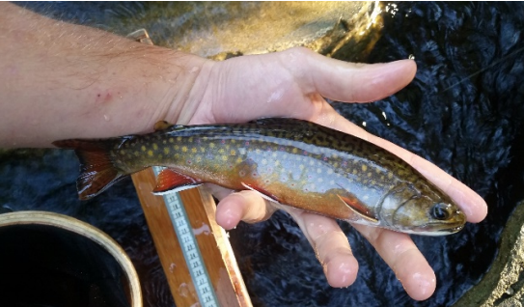
Restore Coldwater and Diadromous Fish Habitat in Howlett Brook Watershed (MA)
Assess Howlett Brook Sub-Basin Habitat Quality for Brook Trout (Sea Run Brook Trout Coalition)

Slide 8
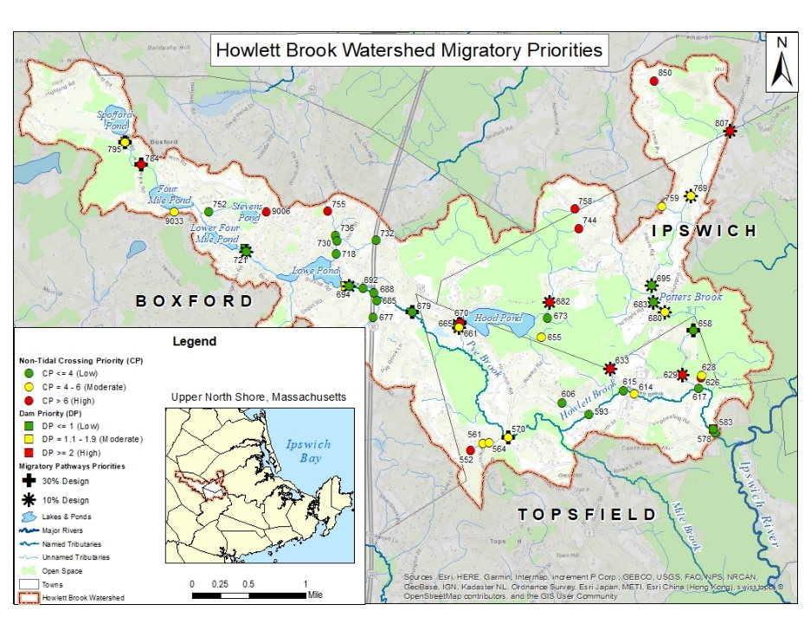
Restore Coldwater and Diadromous Fish Habitat in Howlett Brook Watershed (MA)
18 Barriers designs produced for Ipswich, Topsfield, Boxford (Trout Unlimited National)

Slide 9
TU & IRWA
Partnering with Communities on Infrastructure Vulnerability,
Flood Resiliency & AOP

Slide 10
TU’s Project Goals
Purpose: To provide technical assistance / design and engineering services for communities interested in reducing infrastructure vulnerability and AOP.
Concept: Create preliminary design and engineering plans to help prepare communities for eligible private, state, and federal infrastructure funding.
Funders supporting this effort: TU's technical assistance program is being supported the National Fish & Wildlife Foundation and private donations.

Slide 11
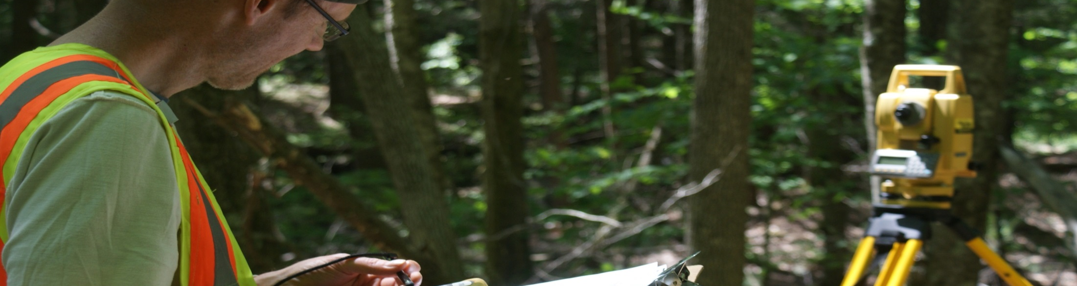
NECP ~ What we do:
Northeast Coldwater Habitat Program (NCHP) ~ What We Do…
Stream Connectivity & Habitat Development
Culvert Assessment
Restoration Monitoring
Culvert Replacement & Dam Removal
Prioritizing project sites
Habitat addition/restoration
Stream Bank stabilization

Slide 12
Northeast Coldwater Habitat Program (NCHP)
Staff Overview
Colin Lawson: New England Restoration Coordinator
Focusing on eastern MA, NH & southern ME
Erin Rodgers: Western NE Restoration Coordinator Focusing on western MA and southern VT
Joel DeStasio: New England Field Manager
Working primarily on Large Wood Habitat Projects across the NE area
Jeff Tenley: Stream Restoration Specialist ~ Engineering Services Working on Projects across New England and New York
Other NE Staff: Tracy Brown (western Connecticut & Upstate NY), and Jeff Reardon (ME)

Slide 13
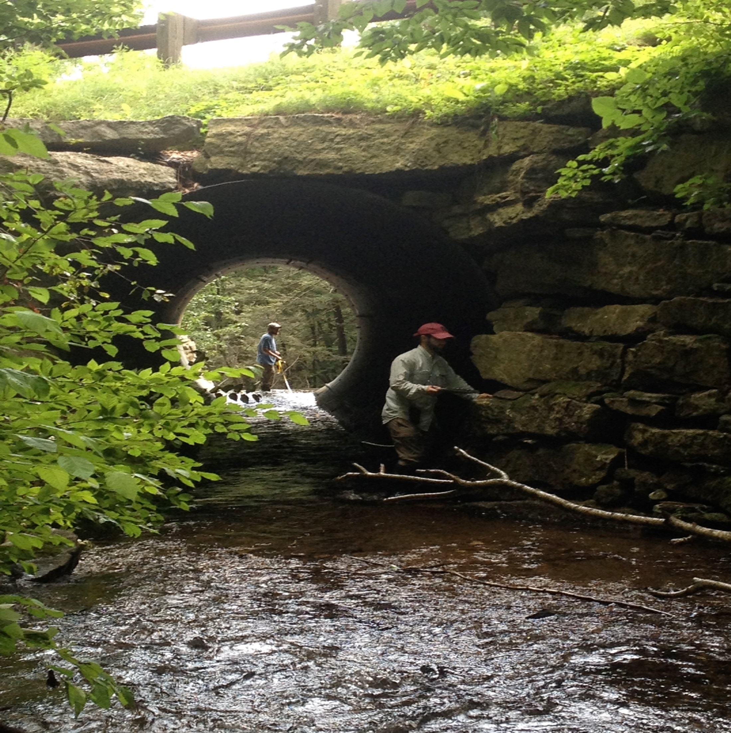
Culvert Assessments – Working Across a Landscape Scale
TU has assessed over 7,500 stream crossings across New England helping communities prioritize their vulnerable infrastructure.

Slide 14
Road-Stream Crossings: Why are so many Undersized ?
Designs prior to 1970s
  Goal was to move water quickly and efficiently
  Build for minimum construction cost
  Design standards
    25-year storm event – if any
    were generally using historic precipitation numbers
1990/2000s – Started to see engineering and ecology fully considered
Currently seeing how larger and more frequent storm events impact undersized culverts and the cost consequences associated with emergency repairs.

Slide 15
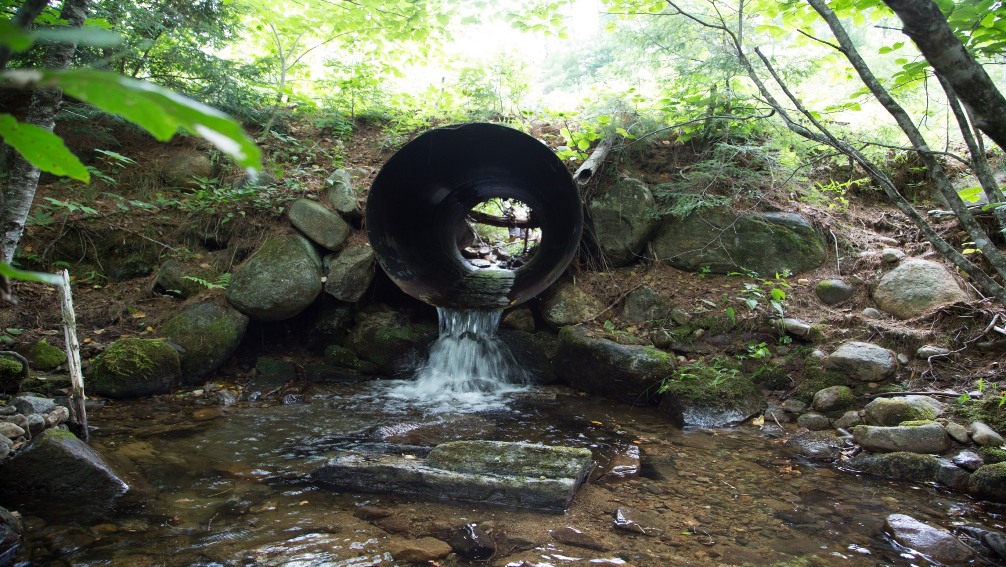
Beebe River,
Campton, NH
Photo: TU

Slide 16
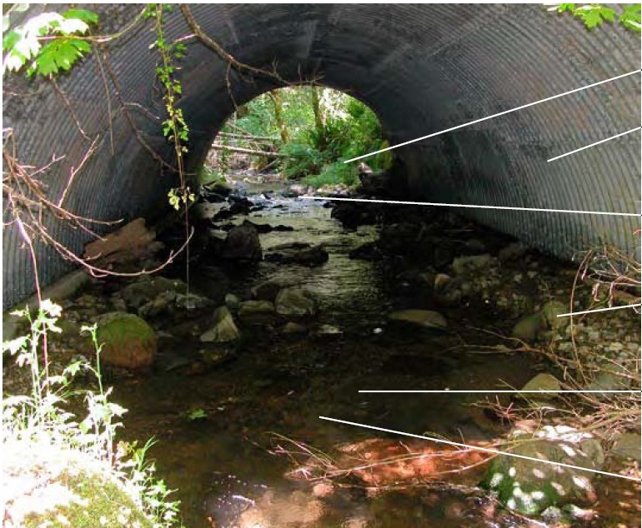
A Well Designed Crossing
Large size suitable for handling most flood flows
Open-bottom arch considered optimum for most conditions
Openness ratio needs to be > than 0.5 ft (sqft / length)
Bankfull width greater than 1.2x stream’s active channel
Water depth and velocity match up and down stream
Natural substrates create good conditions for stream biota

Slide 17
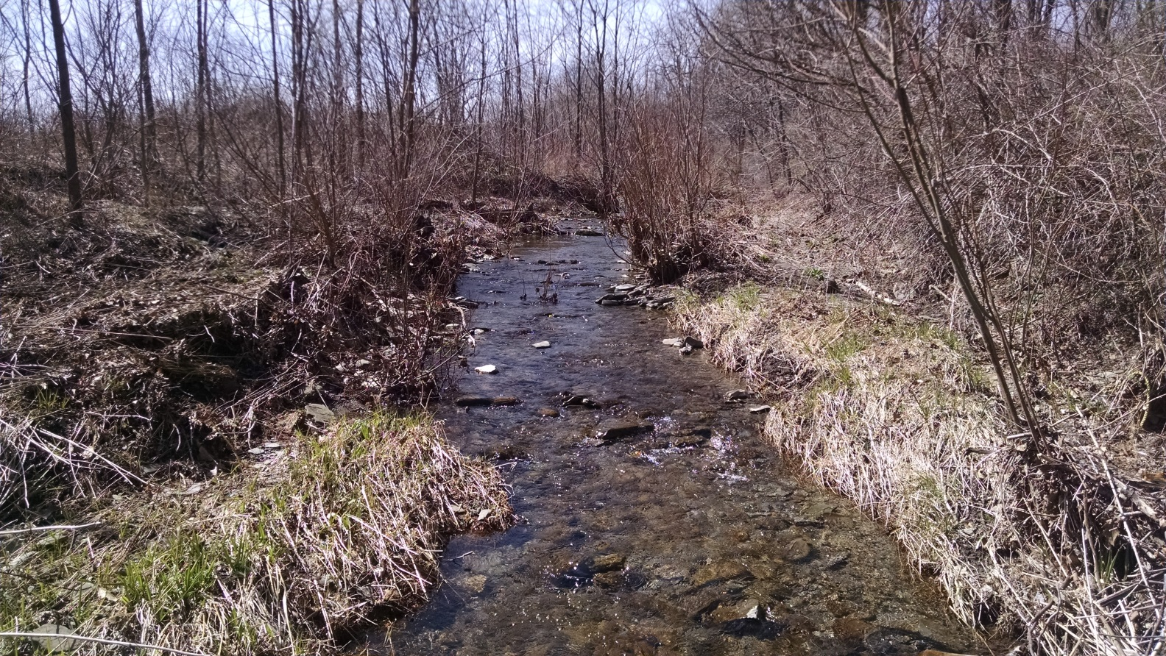
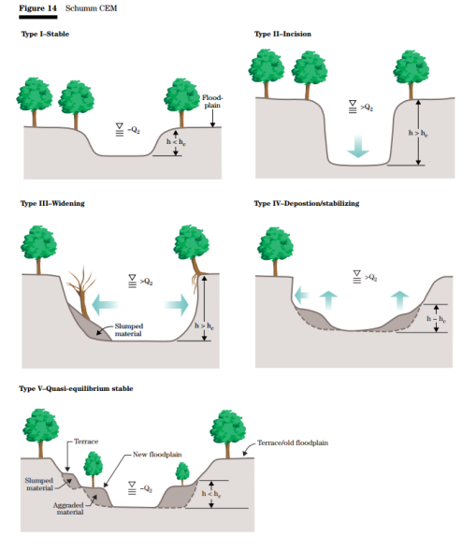
How wide does a resilient road stream crossing need to be?
Source: 7
Spring Brook,
Hector, NY
Photo: TU

Slide 18
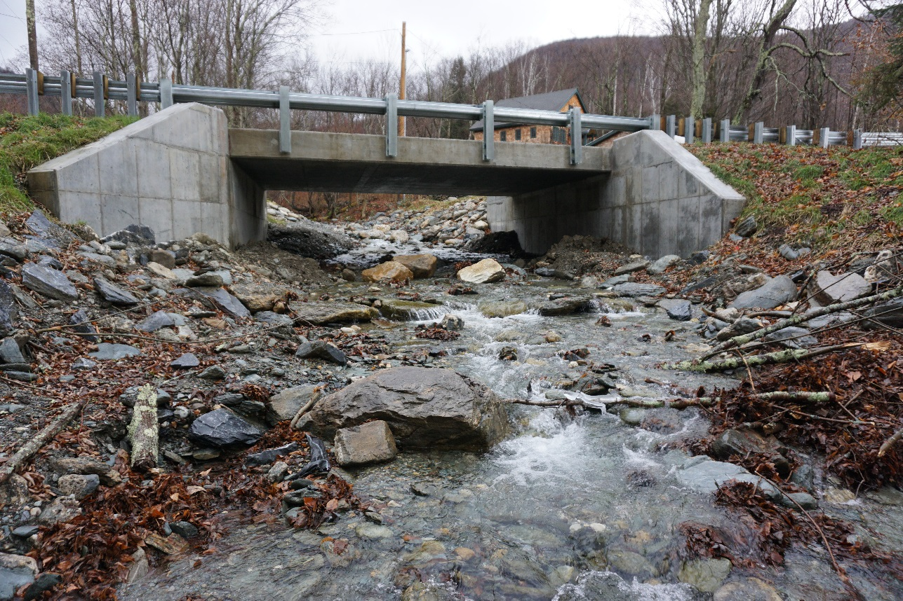
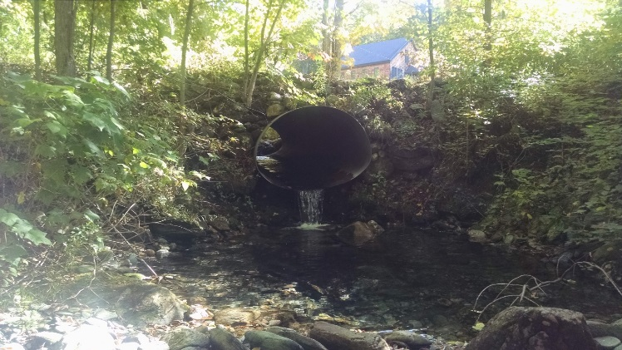
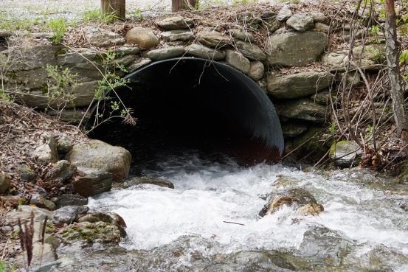
Infrastructure Vulnerability: Undersized Road-Stream Crossing
Mettawee River, Dorset, VT ~ Photos: TU

Slide 19
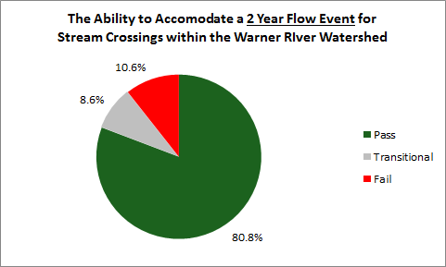
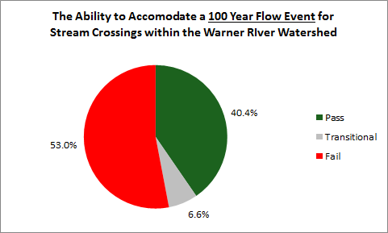
Infrastructure Vulnerability:
Average Results across most watersheds we have assessed…!

Slide 20
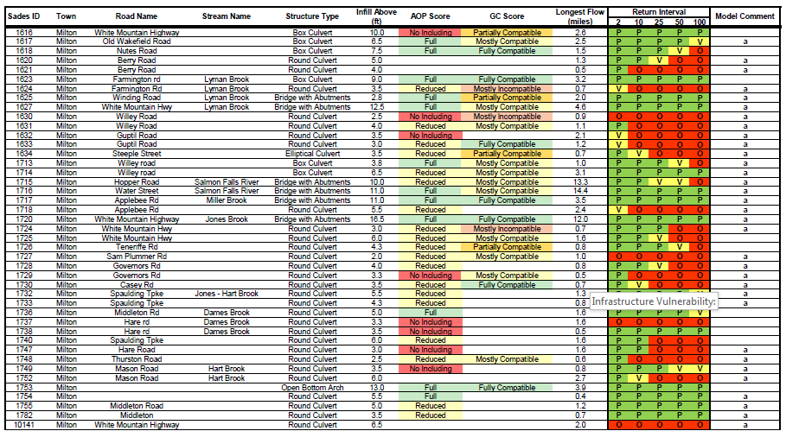
Infrastructure Current Conditions
Example of
Tabular
Results

Slide 21
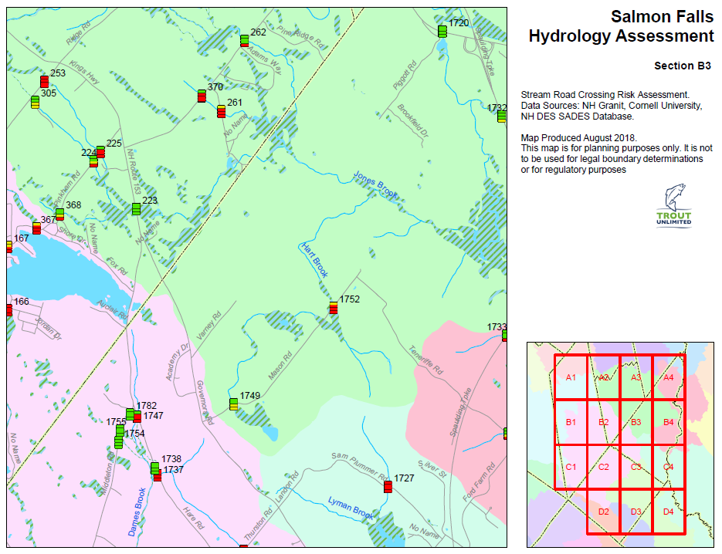
Infrastructure Showing Hydraulic Vulnerability Mapped
Infrastructure Current Conditions

Slide 22
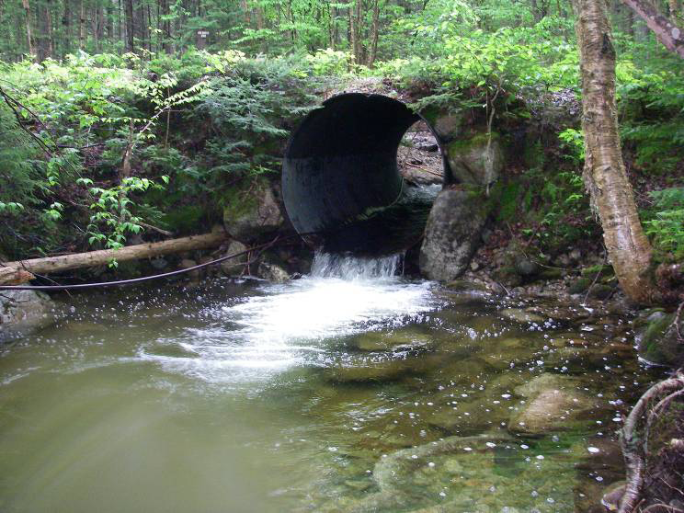

Initiating a Project ~ Figure Out the Funding
Identify how your priority restoration site meets funder’s goals:
  AOP – significant coldwater / protected habitat
  Available matching funds
  Easy target (road class / size)
  Emergency Services
  End of structure’s life
  Hydraulic Constriction
  Private / Conservation Land

Slide 23
Additional Metrics Used To Justify Funding
1. Up/down stream barriers
2. Conserved lands
3. Habitat integrity
4. Hydrologic capacity
5. Impervious surfaces
6. Land cover / Land Use
7. Emergency Services
8. Natural communities
Up / down stream habitat
10. Quality of stream habitat
11. Rare / endangered species
12. Restoration Expense
13. Severity / Age of barrier
14. Species presence / absence
15. Stream flood risk
16. Stream flow regime
17. Town / State matching support
18. Water quality

Slide 24
Expectations of Received Funding
Connectivity
Depending on goals, which theoretical road-stream crossing upgrade would give you the most bang for the buck?
U/S
Miles = 2.0
U/S
Miles = 4.5
U/S
Miles = 0.5
River Road

Slide 25
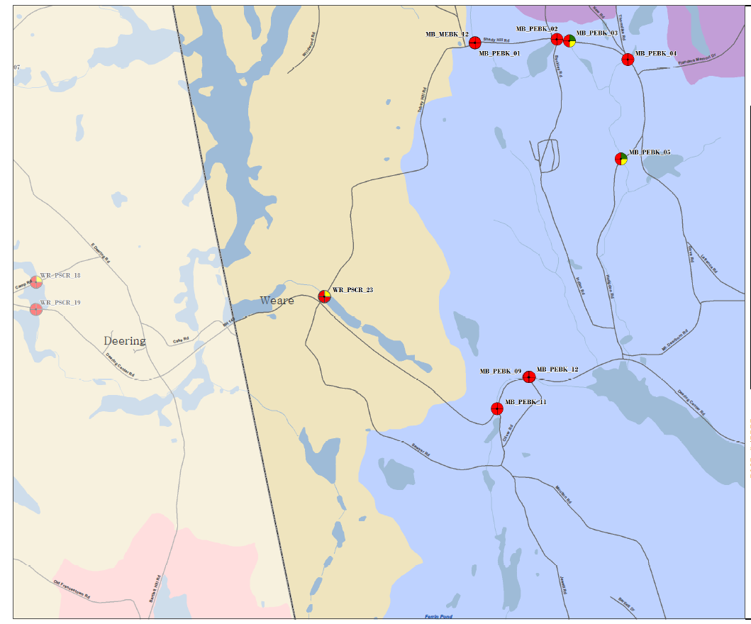



Make the Case for Funds Requested
Outline the site’s benefits
Better access to emergency services
Reduced long term maintenance expenses
Reconnected aquatic / terrestrial habitat
Protection of wetlands and other natural communities
Focus should be on addressing the funder’s targeted interests

Slide 26
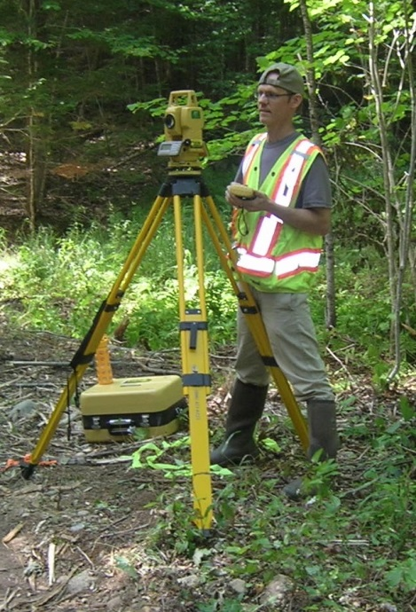
Create Both Community & Technical Team
Assemble a technical team to support project:
        create a conceptual plan (~$5k)
            30 % design plan for initial cost estimates – used to solicit grant funding
            collect: hydrology, hydraulics, geo-technical
        full engineering planset (~$15k-30k)
            finalize designs for accurate funding needs
            create a detailed cost estimate for bidding
        review funding opportunities
            develop list of grants, $’s needed, timeline
Permitting:
            can be completed internally
            develop partnerships with state and federal agencies
            should be able to submit as a “restoration” project

Slide 27
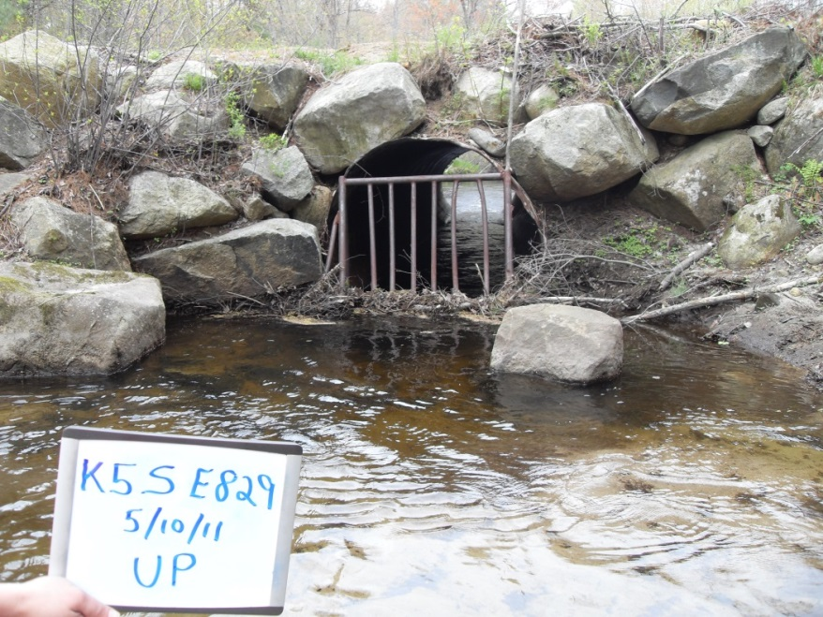
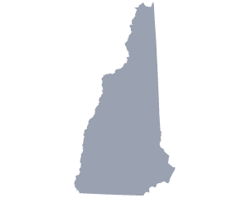
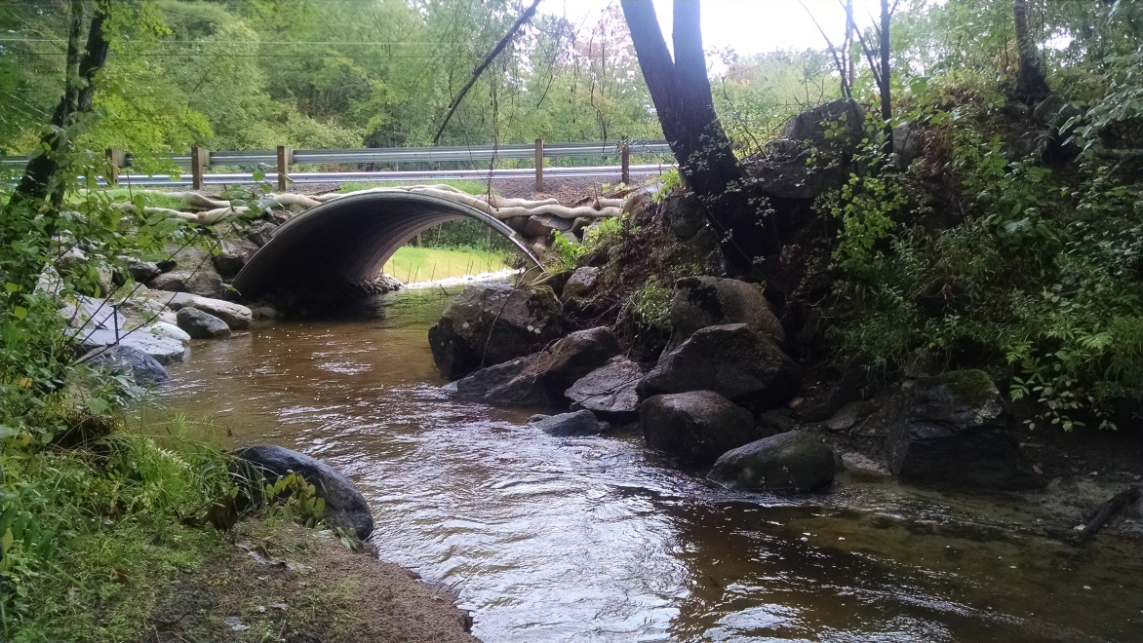
Completing a Project!
Hale Hill Road, Swanzey, NH ~ 2016 Construction
Re-opened 10 miles of interconnected habitat
After
Before

Slide 28
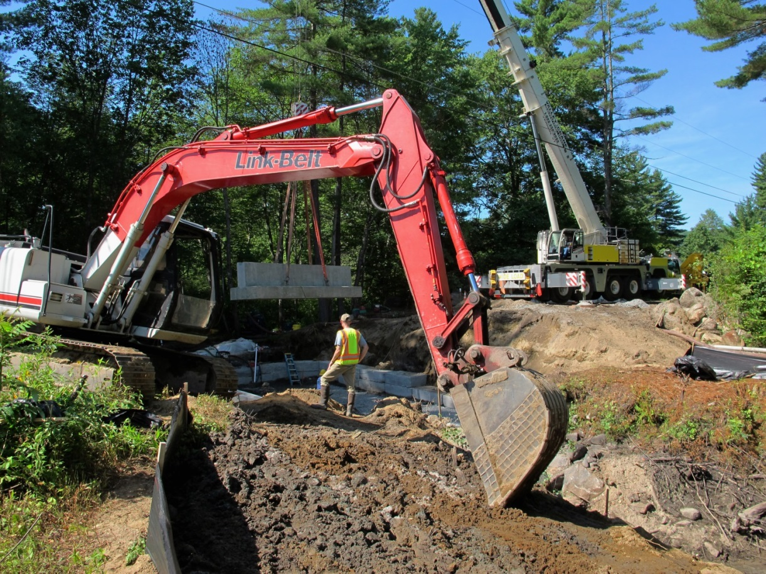
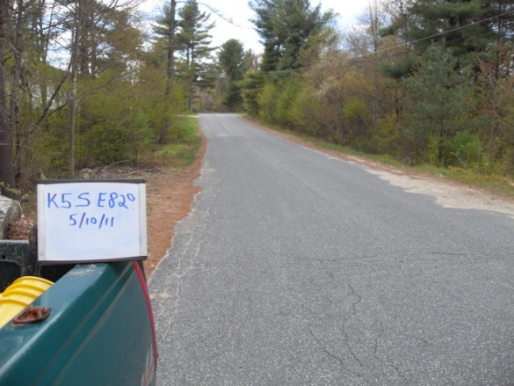
The Construction Window
It does take time to bring the pieces together:
a project team
commitment from the town
initial design review / plans
cost estimates
funding
permits
contractors
and the list goes on and on and on…

Slide 29
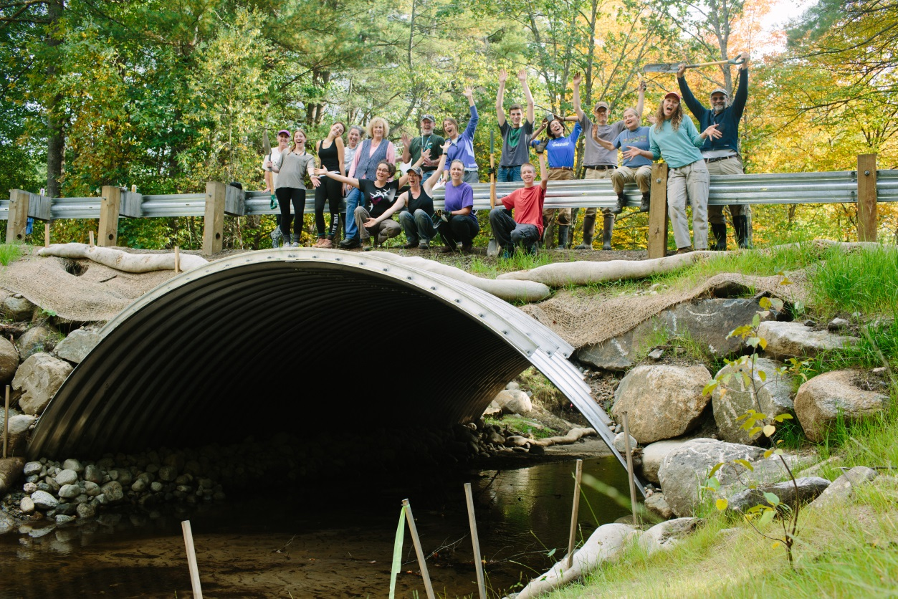
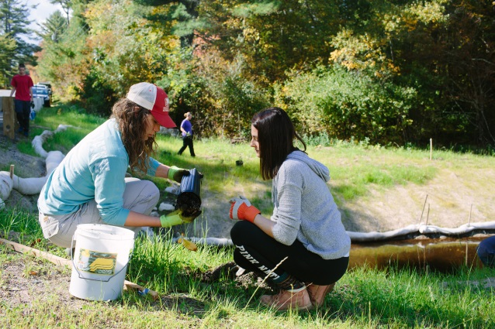
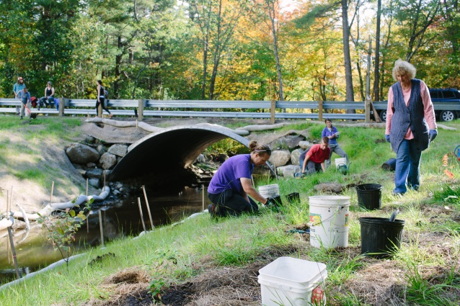
Its all about the Project Team ~ you can create a great all inclusive restoration…
Falls Brook Project ~ Grants = $170,000 / Town = $20,000 / In-kind Services = $30,000 …

Slide 30
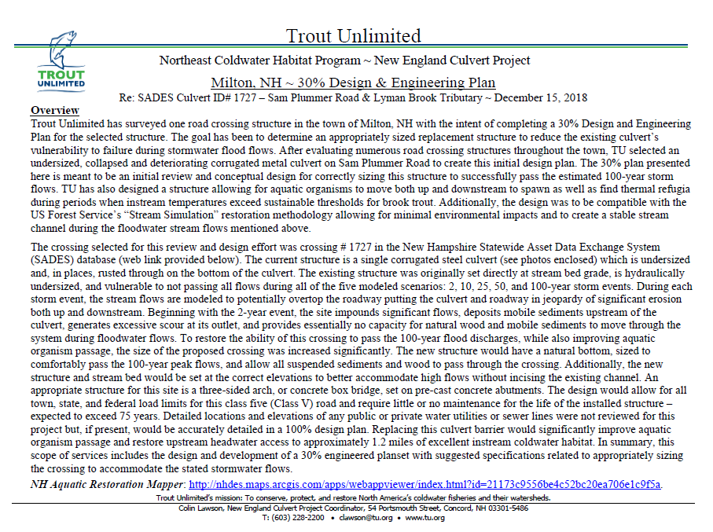
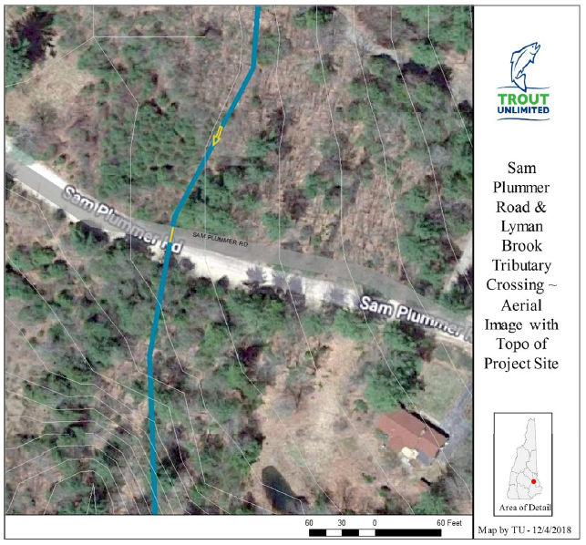
Restoration Objectives ~ 30% Engineering Plans
Made possible by generous funding from NHCF & PREP

Slide 31
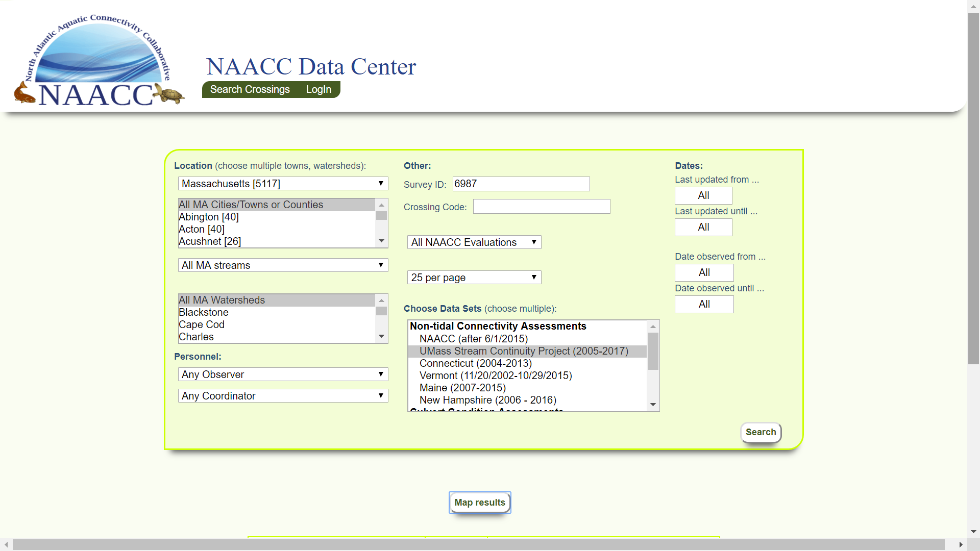

Slide 32
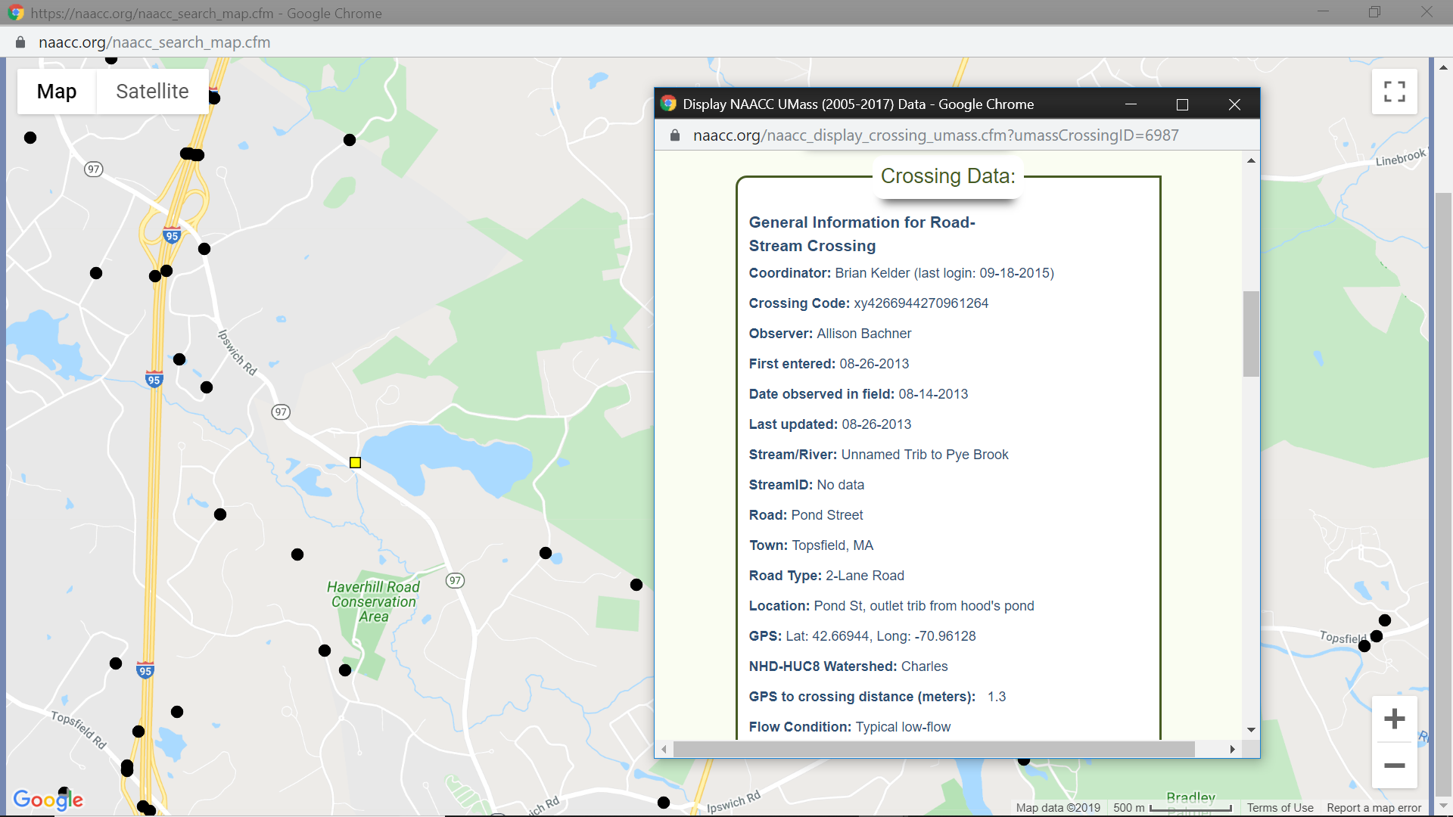

Slide 33
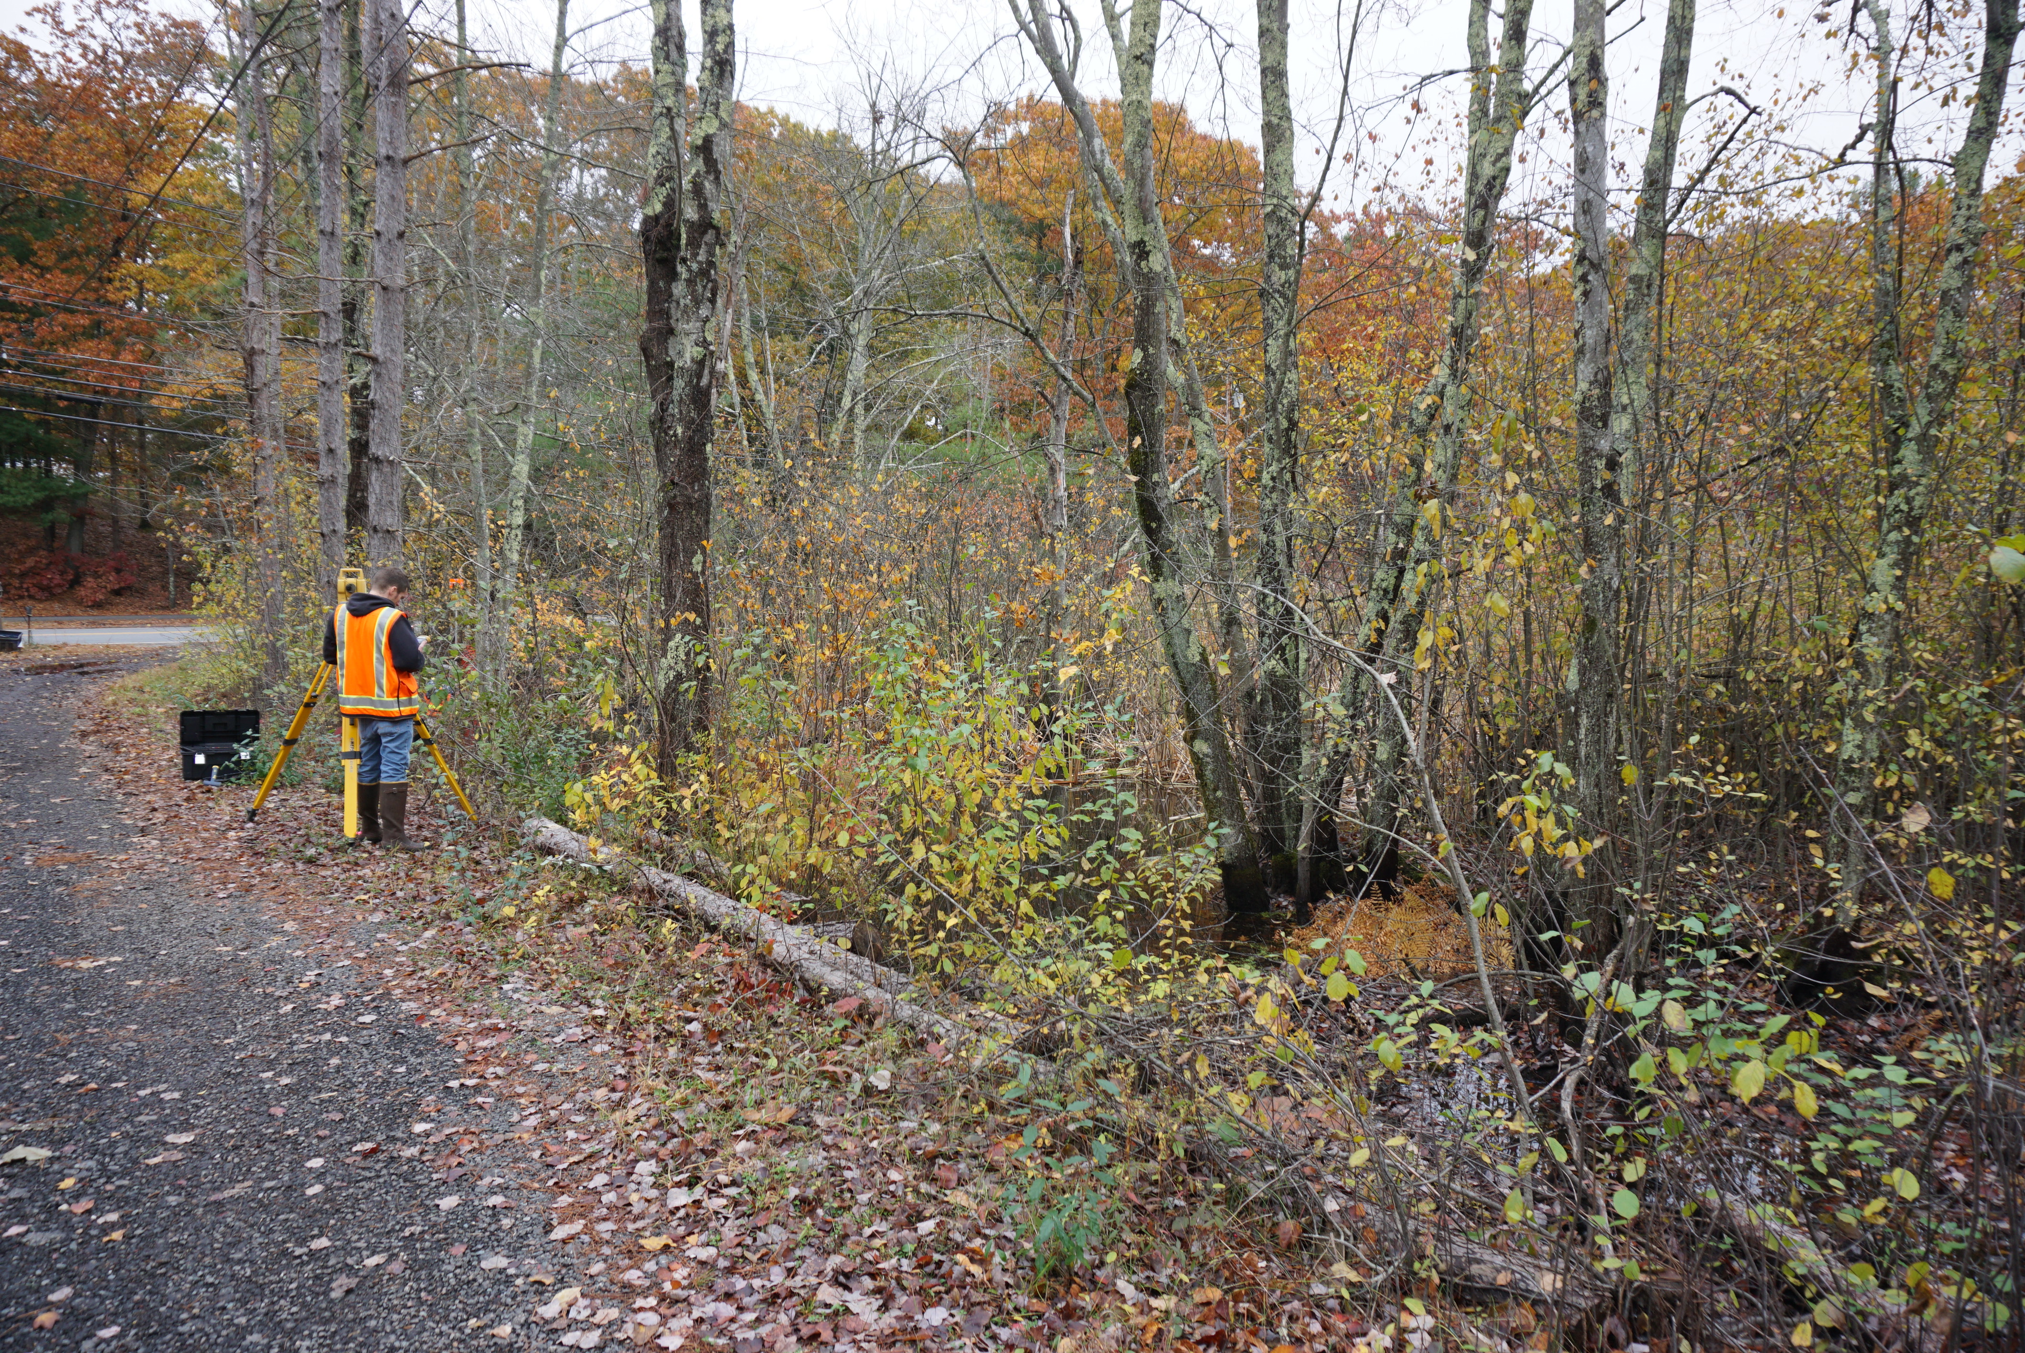
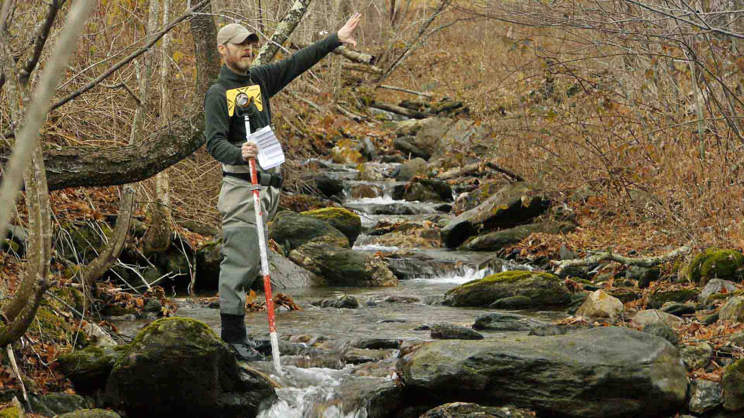
Baseline Surveying to Capture Numerous Landscape Features

Slide 34
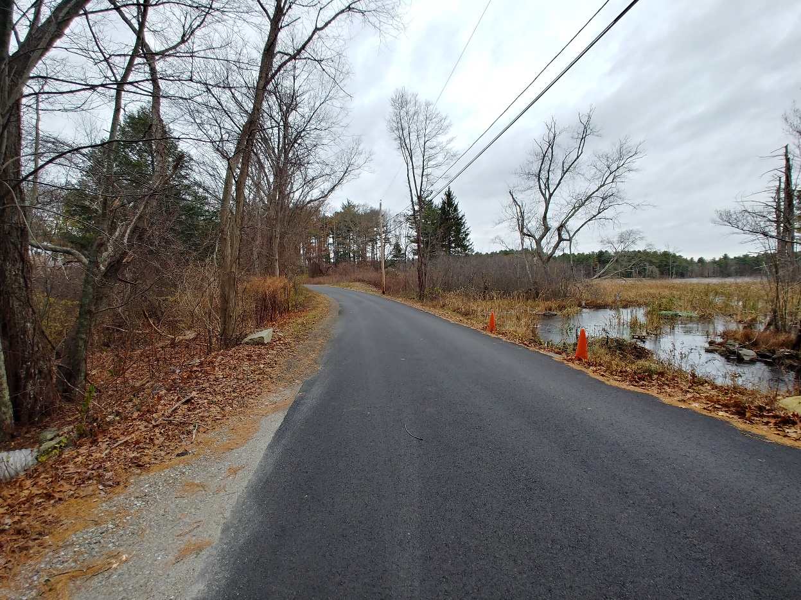
East Street, Topsfield

Slide 35
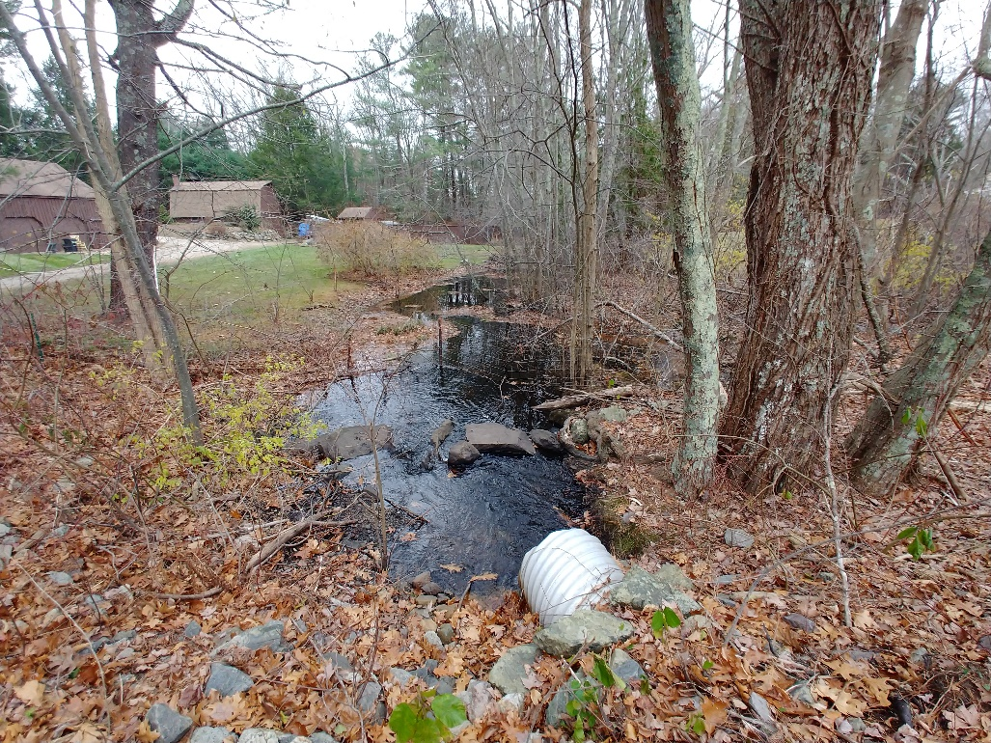
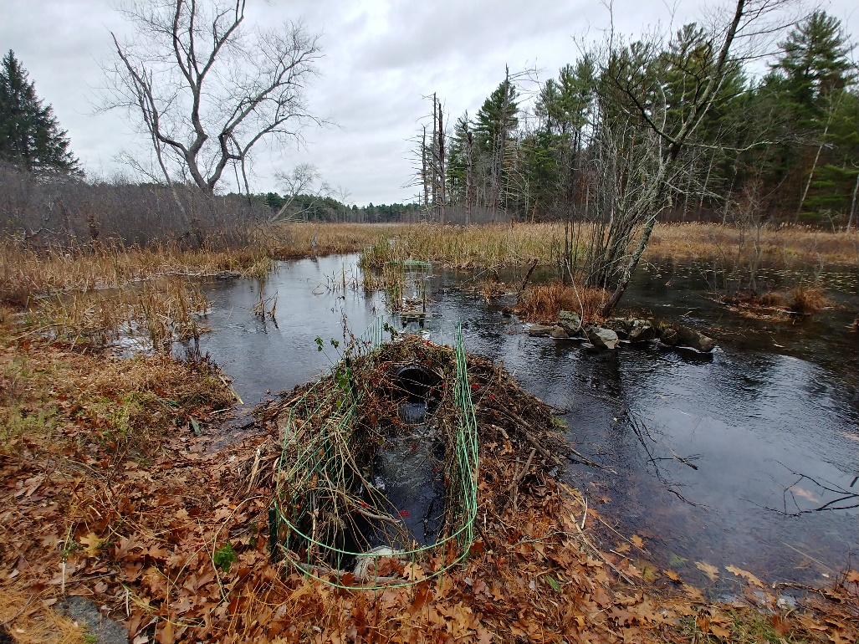
East Street, Topsfield

Slide 36
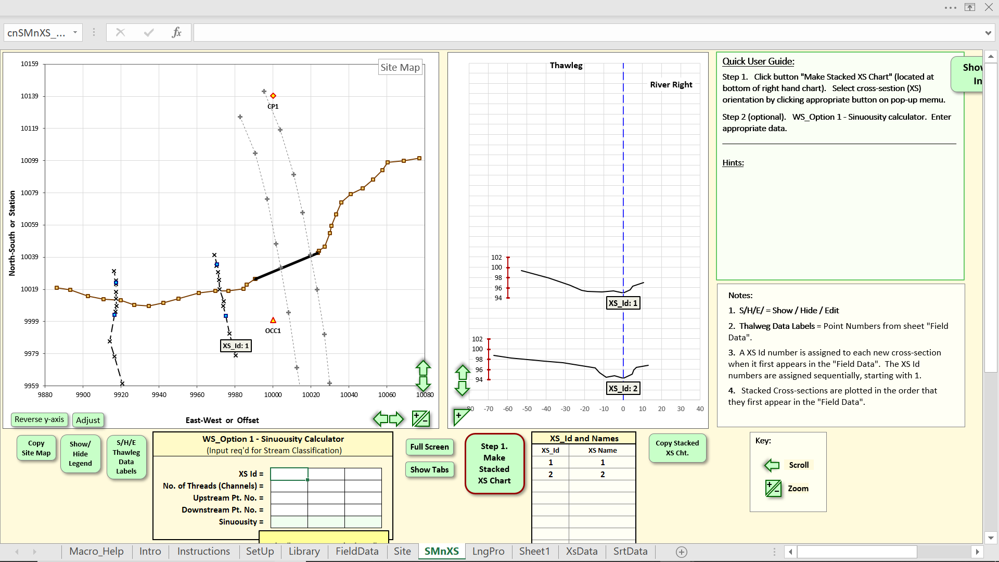
East Street, Topsfield

Slide 37
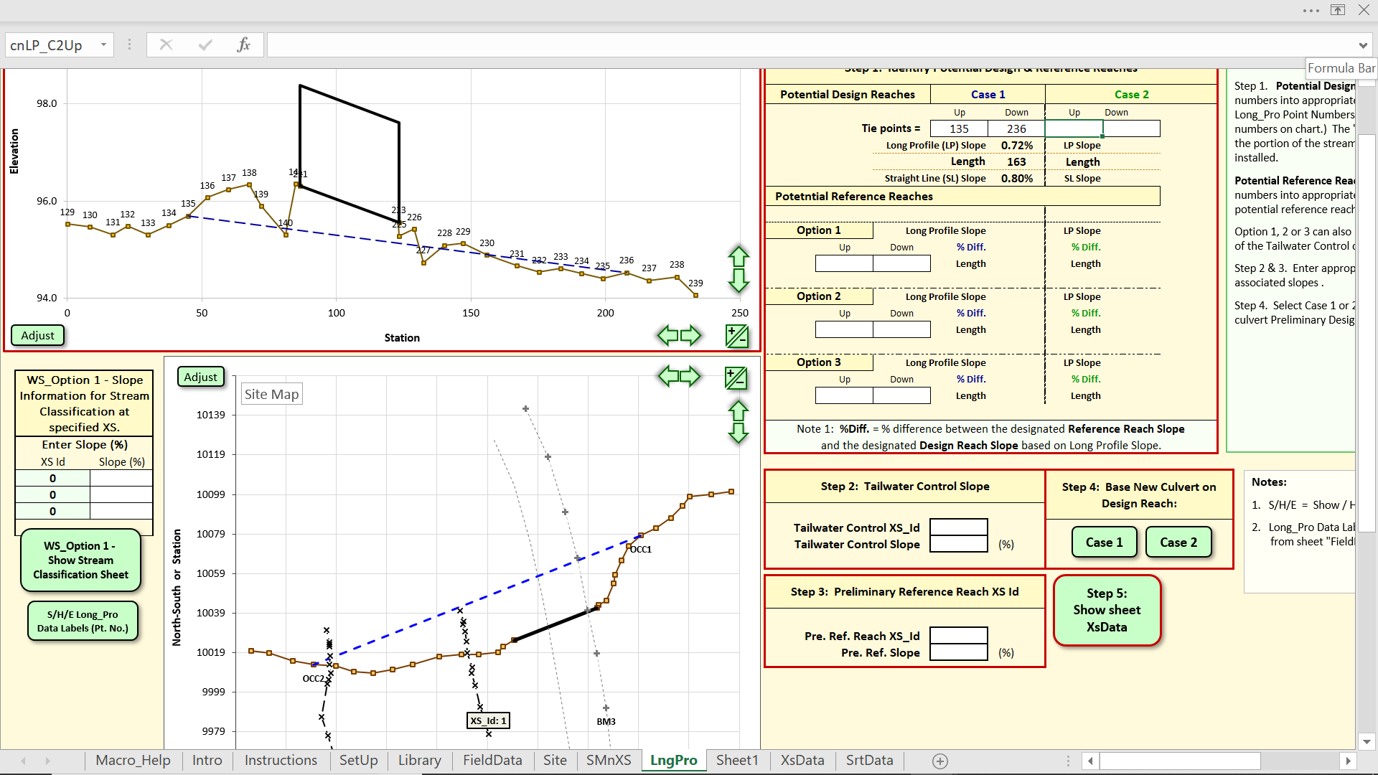
East Street, Topsfield

Slide 38
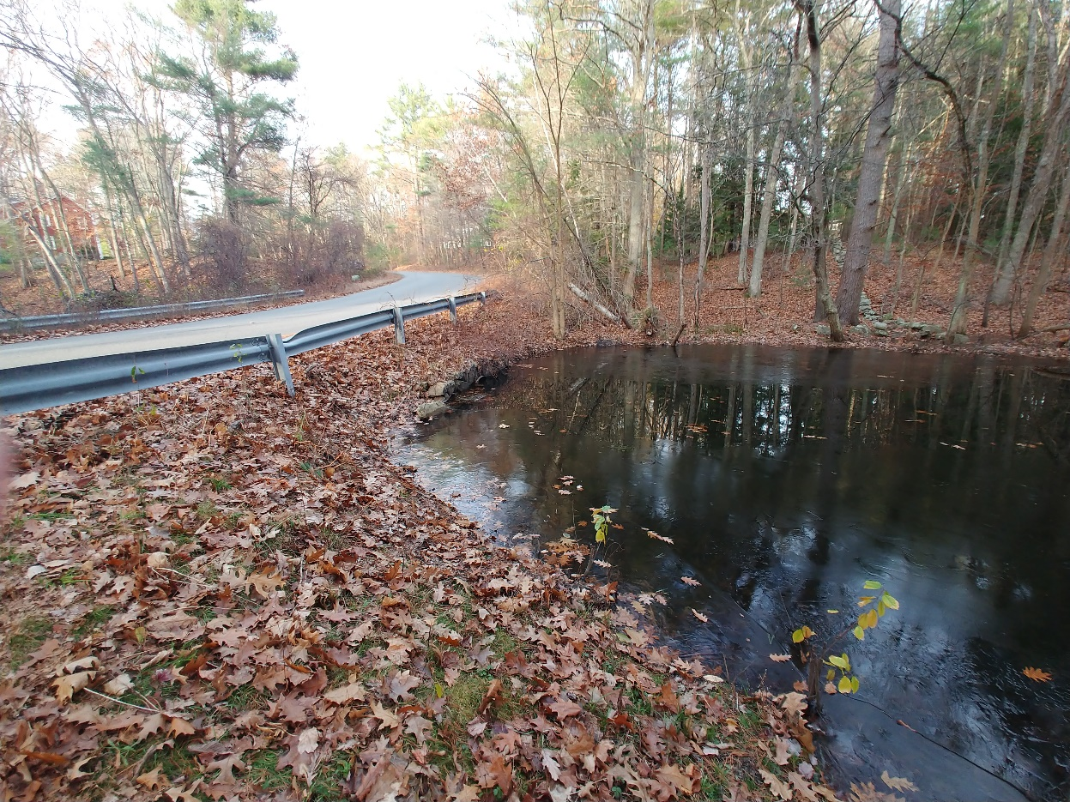
Pye Brook Lane, Boxford

Slide 39
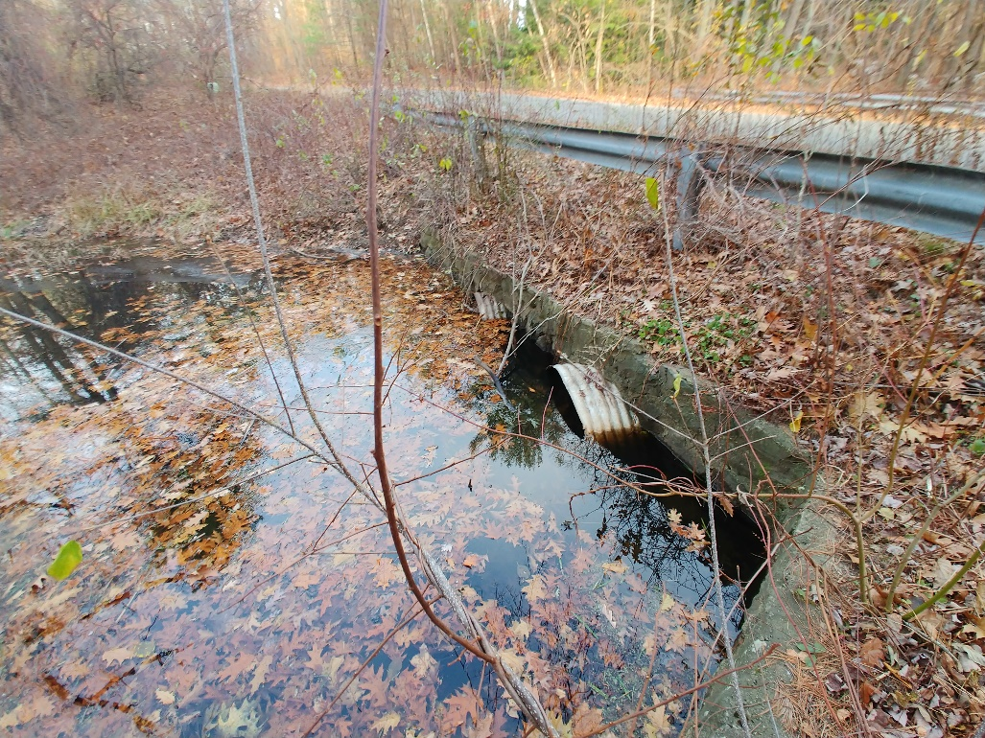
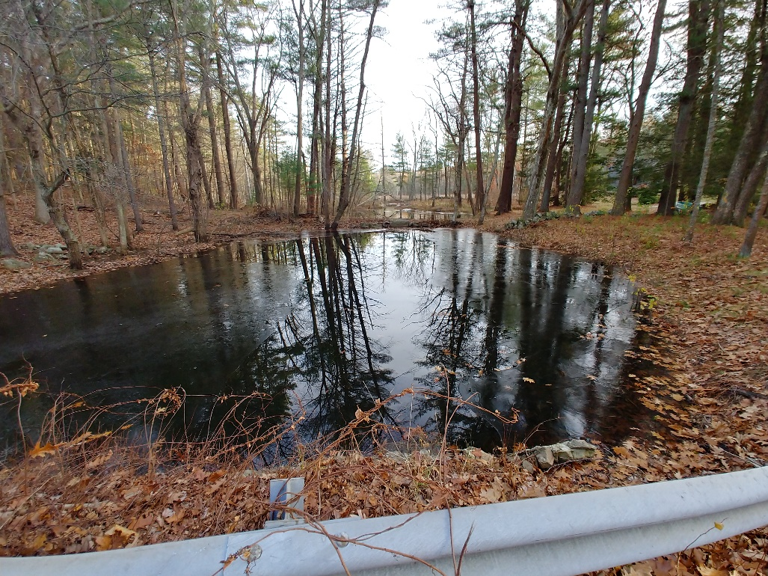
Pye Brook Lane, Boxford

Slide 40
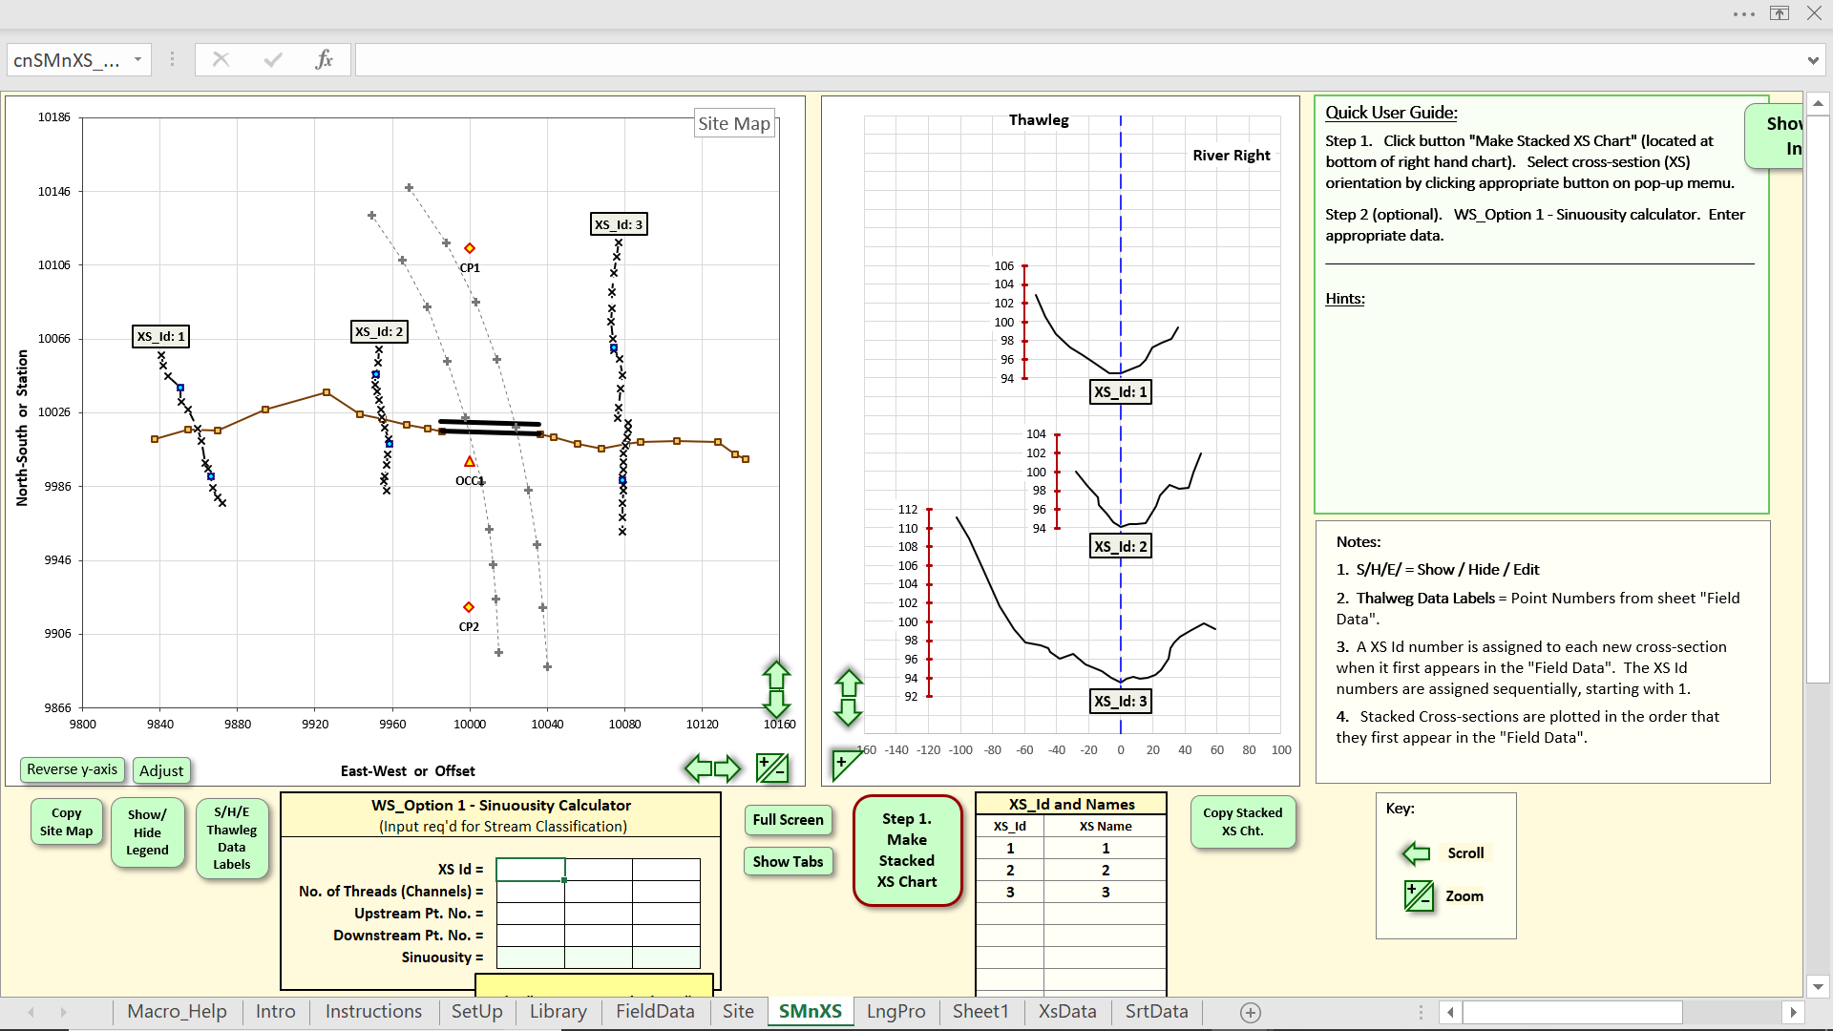
Pye Brook Lane, Boxford

Slide 41
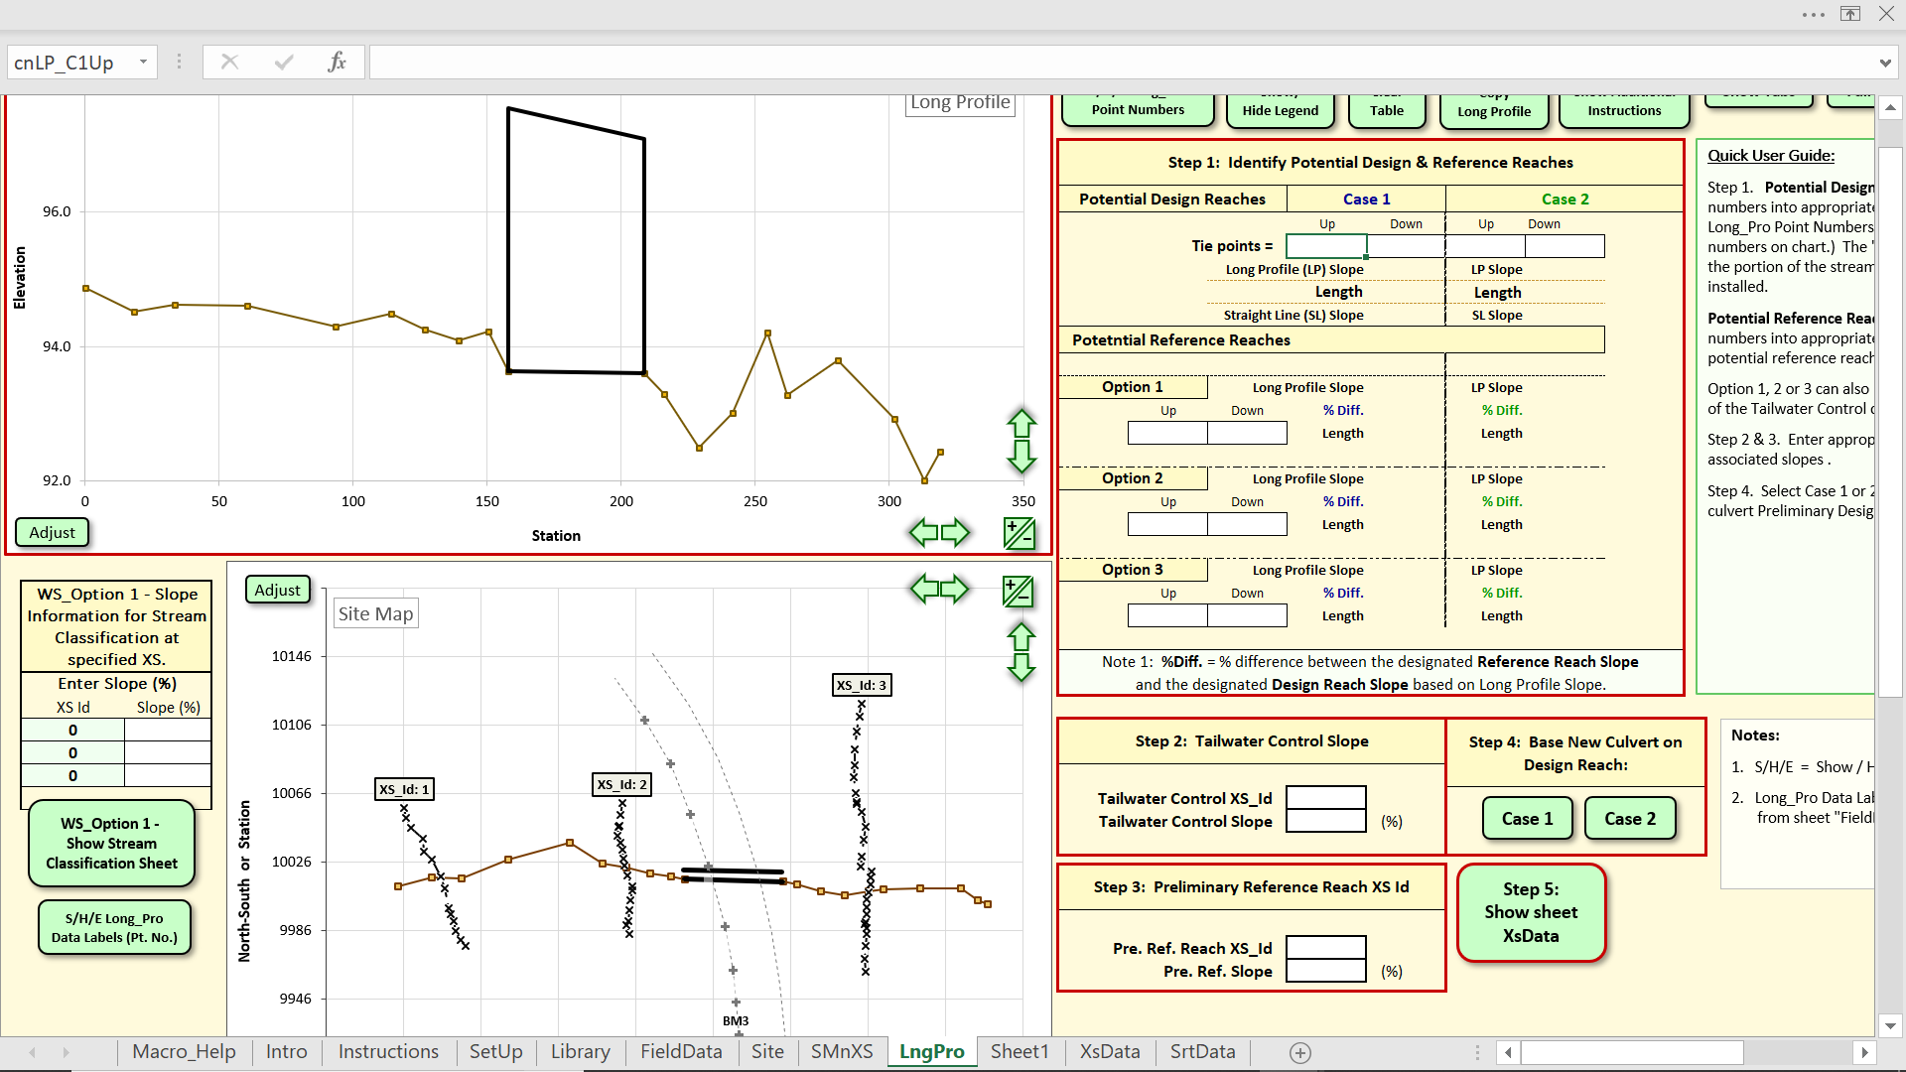
Pye Brook Lane, Boxford
Pye Brook Lane, Boxford

Slide 42
Restoration Objectives ~ Proposed Replacement

Slide 43
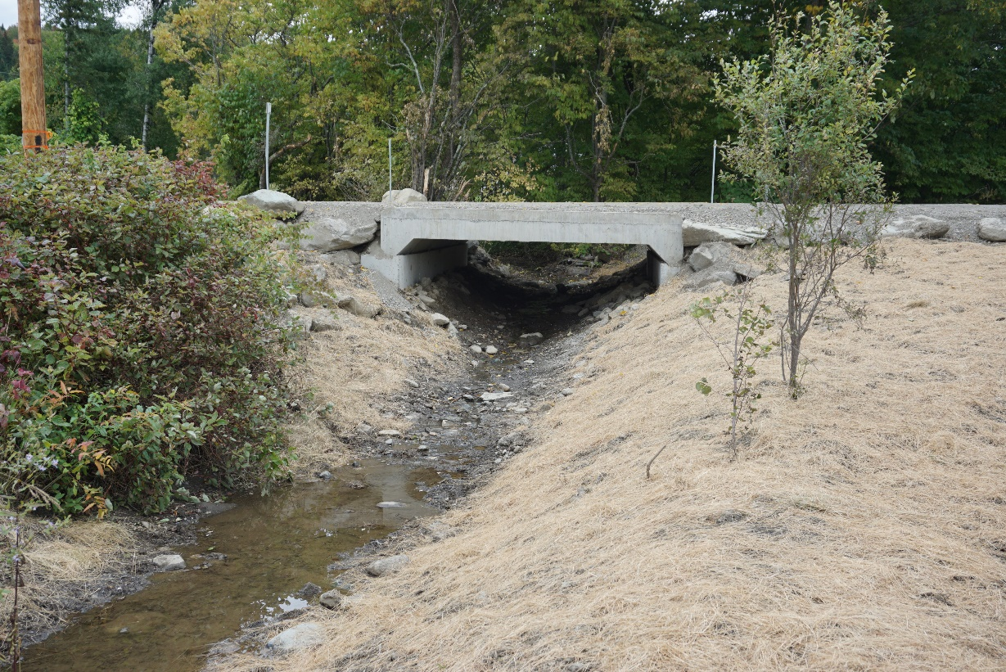
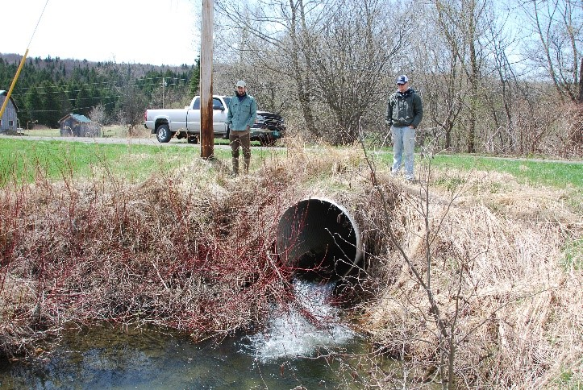
Restoration Completed 9/2019 – Tabor Road, Pittsburg, NH
Before
After

Slide 44

Thank you…
Kaitlyn Shaw
kshaw@ipswichriver.org
978-412-8200
Colin Lawson
colin.lawson@tu.org
603-228-2200
Joel DeStasio
joel.destasio@tu.org
603-228-2200
Avalanche Brook,
White Mountain National Waterville Valley, NH
Photo: TU

