Slide 2
The Greenscapes North Shore Coalition works to promote and protect beautiful landscapes for clean and plentiful water in the North Shore communities of Massachusetts
Notes:
2
The Greenscapes Coalition is a statewide coalition of watershed groups and municipalities
Our North Shore Coalition includes SSCW, 8Towns & GM, IRWA, and MRWC
We partner with municipalities – to provide outreach & education on water-related issues, including water conservation and water pollution
Our goals are to:
Educate and empower residents to seek cleaner and more available water resources
Serve as a resource to help homeowners and businesses save water and reduce pollution
Provide outreach and education to support municipal compliance with water-related regulatory requirements, including the new federal stormwater permit and water conservation programs

Slide 3
in YOUR Community
MS4 Permit Support
WMA Permit Support
School Programming
Public Presentations
And More!
3

Slide 4
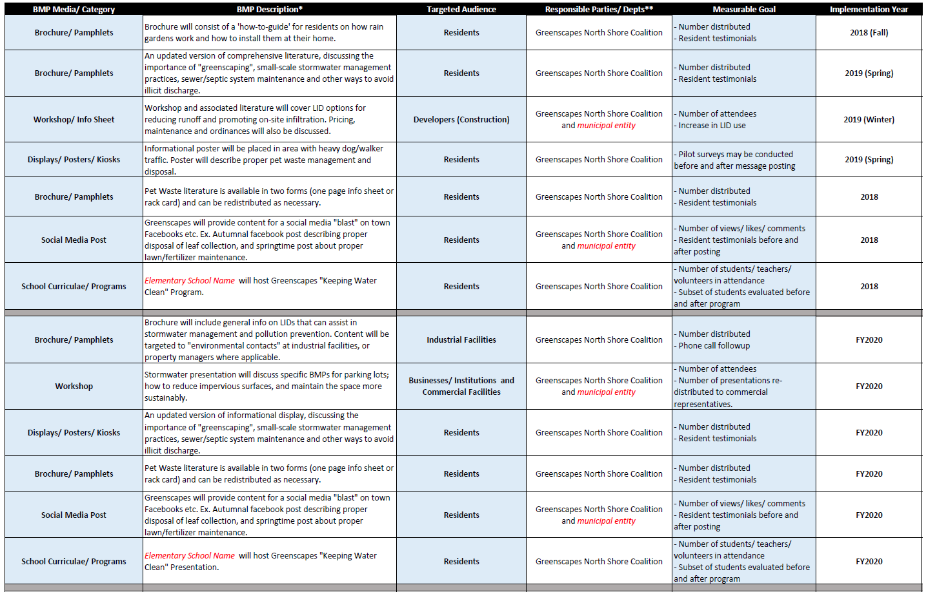
NOI (5 year deliverable plan)

Slide 5
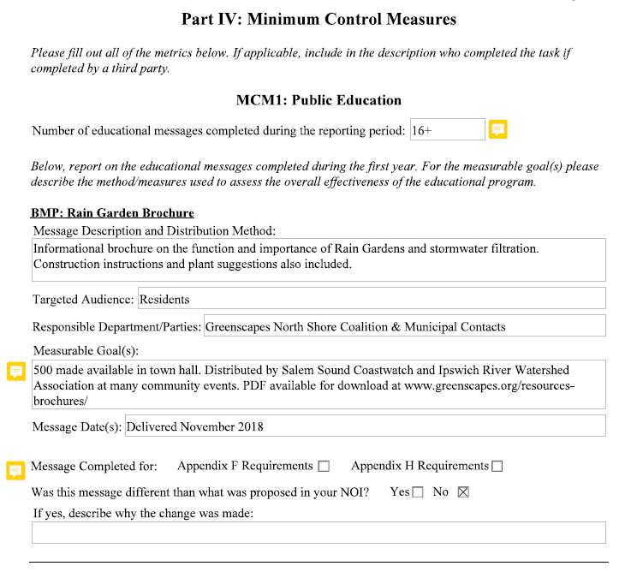
Summary to be expected every year.
Can be personalized for each community (KWC numbers, event attendance, etc)
Greenscapes “Umbrella” – all communities can report on all events, as long as they were advertised and “made available” to their constituents.
Annual Report “Template”

Slide 6
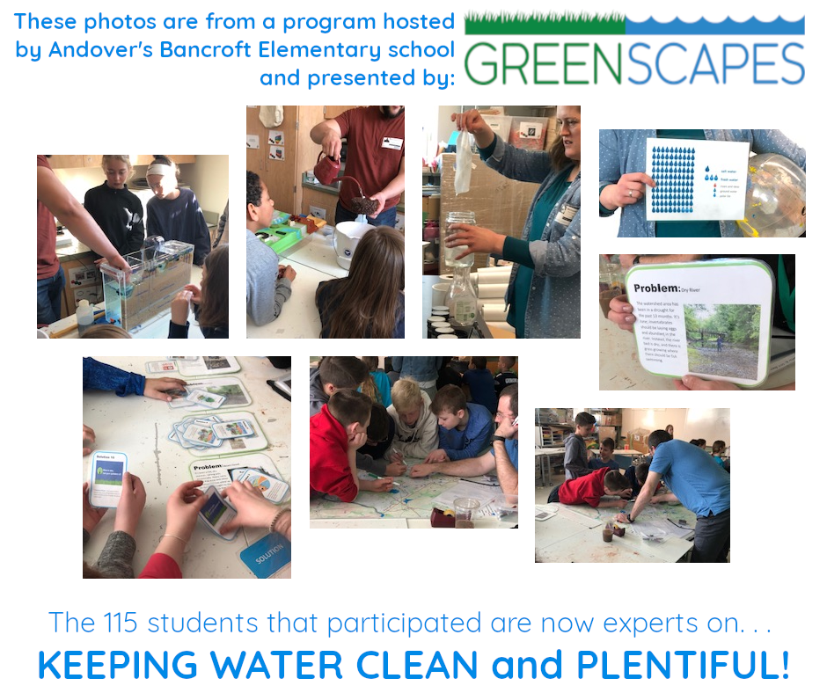
Education Program
Designed for grade 5.
Hands-on, interactive stations for students conducted by Greenscapes educators and parent volunteers.
Pre-program PowerPoint presentation with community specific information.
Take-home materials for families to learn about water quality, sustainable landscaping and water conservation.

Slide 7
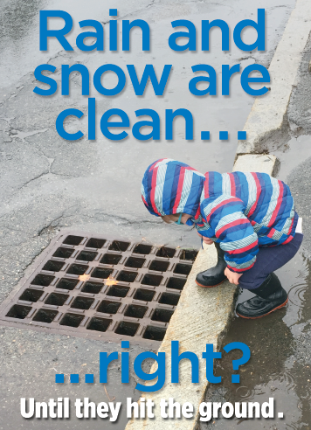
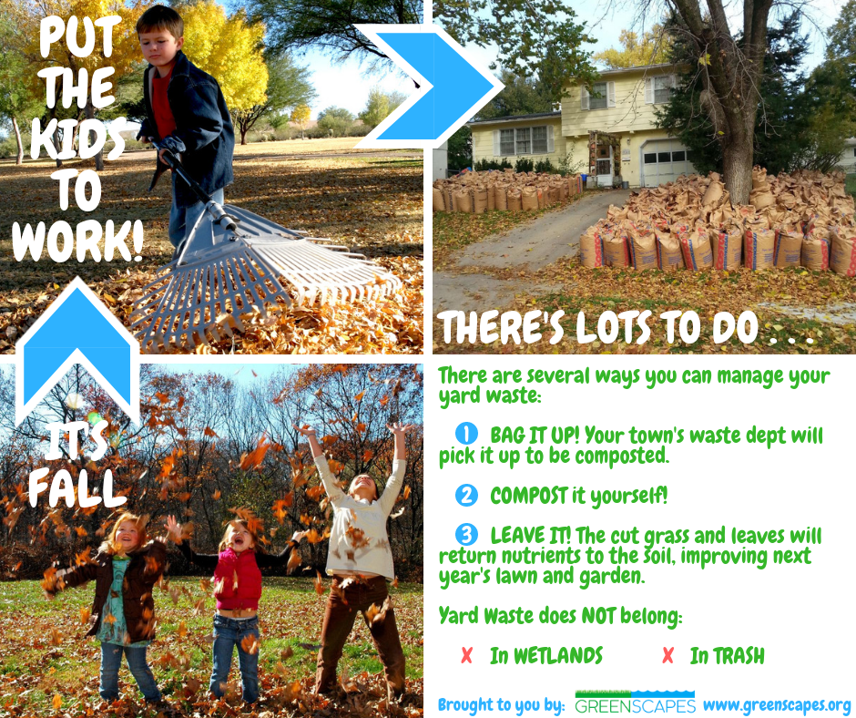
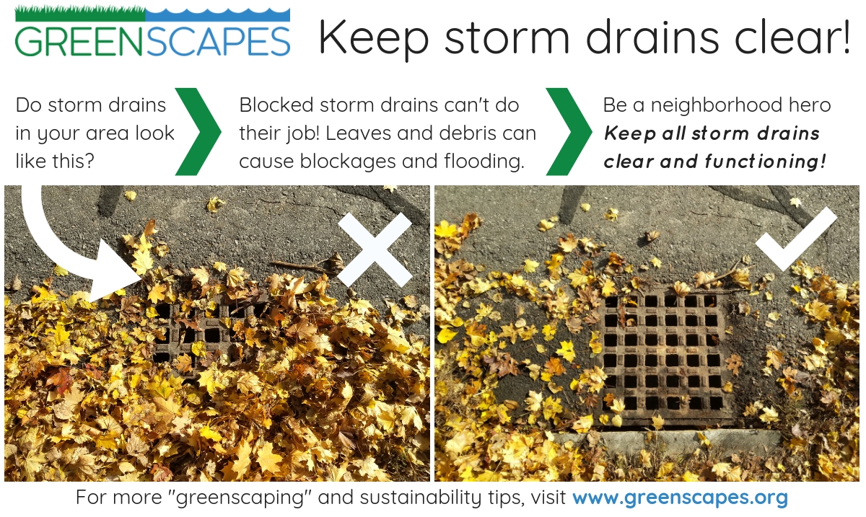
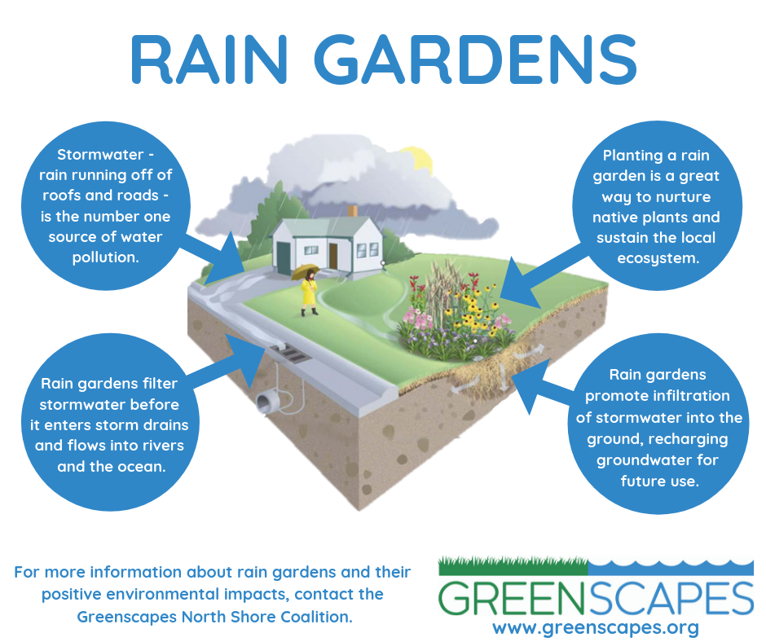
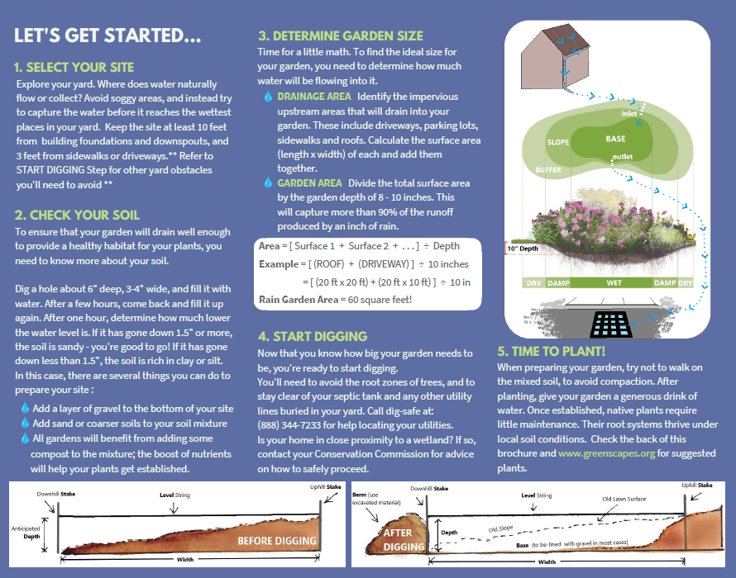
Other Resources
“Greenscaping 101”
Rain Garden Workshops
LID Workshops
Composting Workshops
Rain Barrel Sale
Annual Summaries
Monthly Social Media Posts
All available at:
www.greenscapes.org

Slide 8
“Where do I share these materials?”
Garden Clubs
Dog Parks
Tabling Events
Citywide Mailings
Public Access TV
Public Library
Conservation Commissions
Stormwater Committees
Recycling Committees
8

Slide 9
Misc. Examples
DPW/Town Facebook pages
Dog License Renewals
Building/Health Inspector office or mailings
Trash/Recycling Barrel Pickup
Newsletters
Senior Centers
Open Space Committee?
Green Team?
9

Slide 10
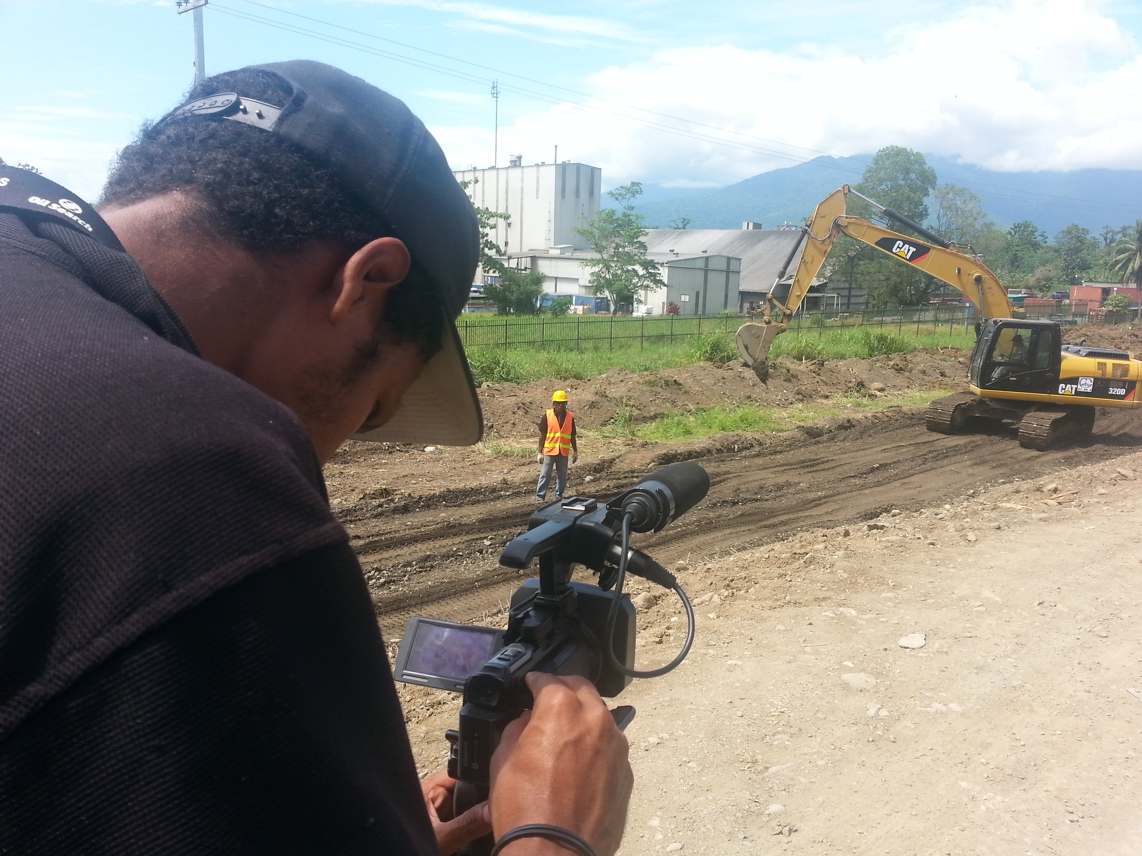
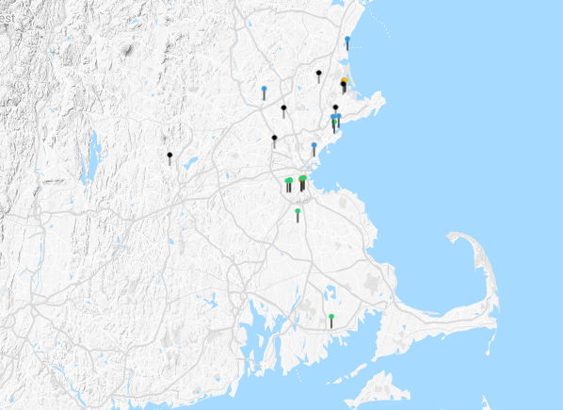
MS4 Assistance Grant 2019 “LID Toolkit”
3 LID Videos
Ongoing Construction
Innovative LID at Schools
LID throughout MA
LID Web Viewer
LID throughout MA
Greenscapes Guide
Magazine Format
24 pages
Plant suggestions
Lawn care tips
LID Survey Form

Slide 11
QUESTIONS?

