Slide 1
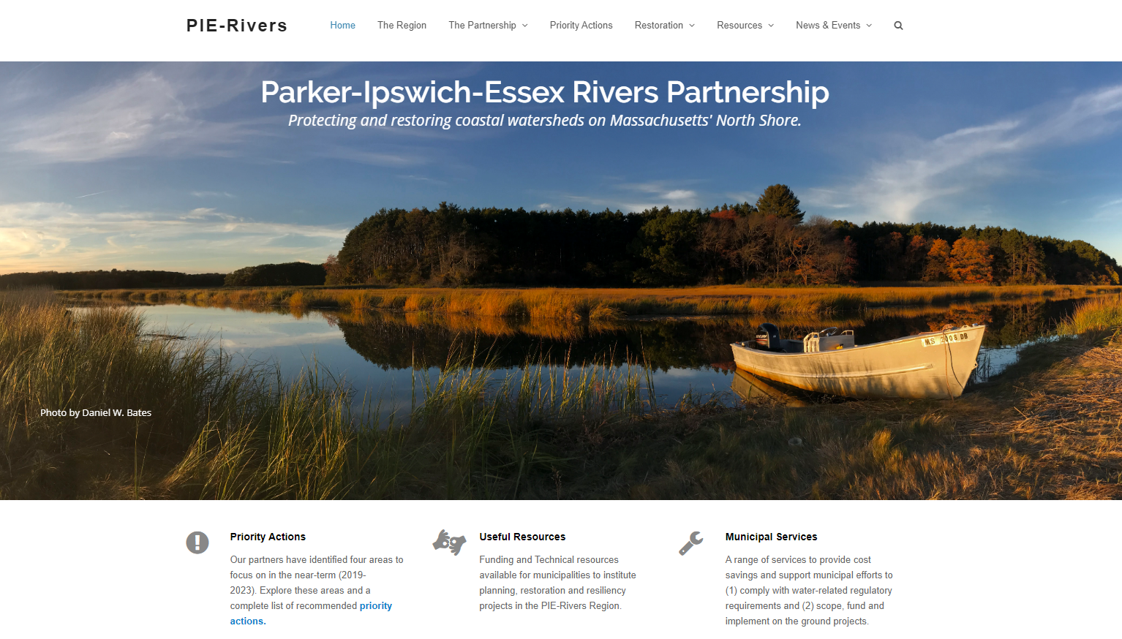
Parker-Ipswich-Essex Rivers
Restoration Partnership

Slide 2
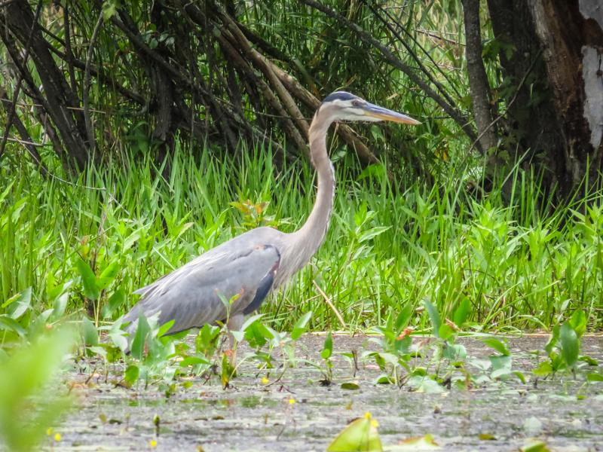
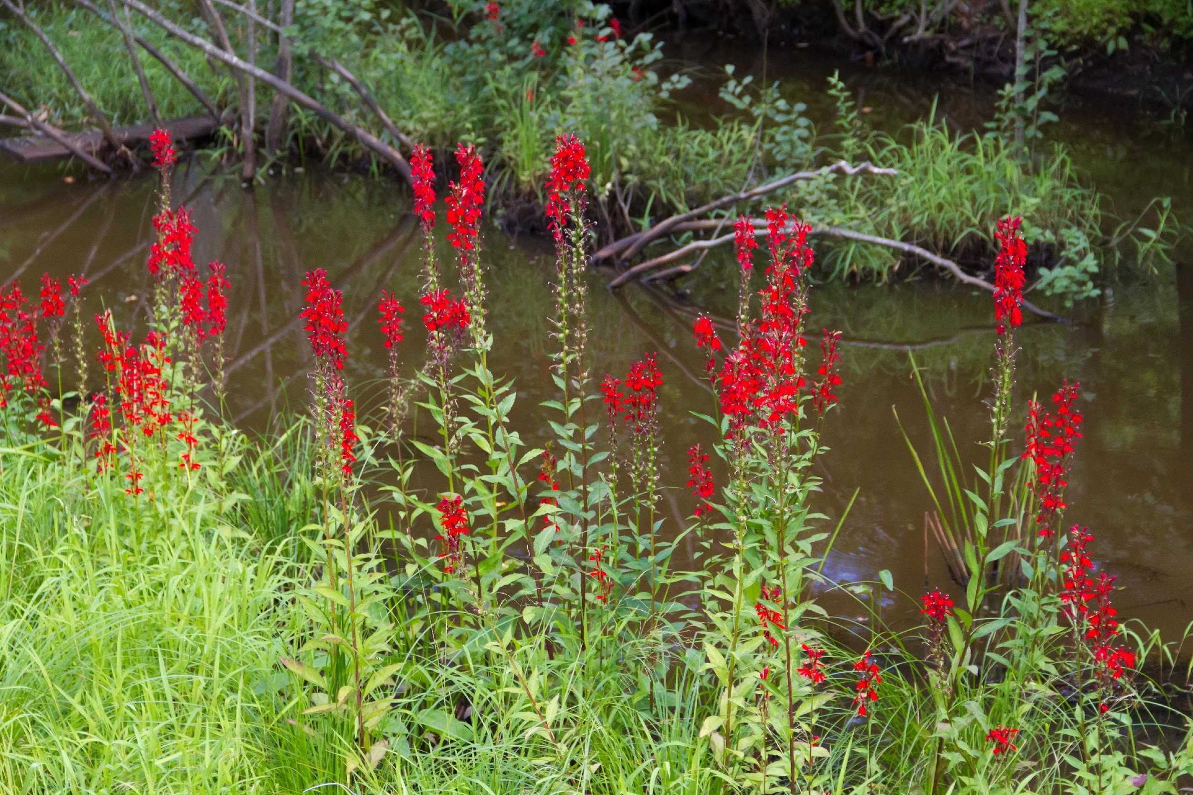
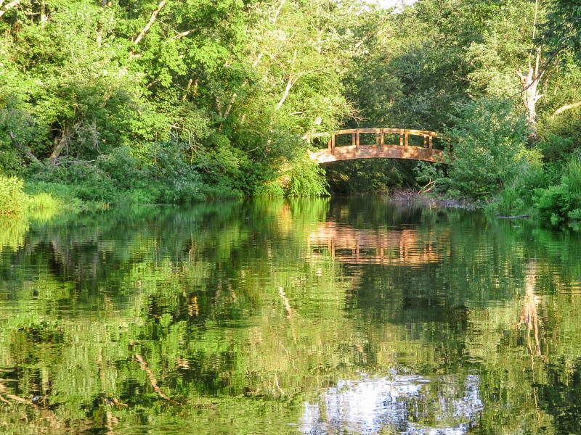
Meeting Agenda
8:00 Coffee & Pie
8:30 Welcome & Overview
8:40 Partnership Business Meeting & 2019 Year in Review
Town Representatives Program Kick Off
8:55 Municipal Vulnerability Preparedness Program
Michelle Rowden, Northeast Region MVP Coordinator
Carolyn Meklenburg, Greater Boston Region MVP Coordinator
9:35 Networking Break: River Run - A Story of Dam Removal in Massachusetts
9:50 Town of Ipswich, Water Neutral Growth Project
Town Planner Kristen Grubbs and Water Director Vicki Halmen
Reducing Lawn watering through community based social marketing: Pilot Project & Toolkit
Michelle Craddock, Division of Ecological Restoration
Duane LeVangie, MA Department of Environmental Protection DEP
10:30 Howlett Brook Restoration Project
Colin Lawson and Joel DeStasio, Trout Unlimited National
Kaitlyn Shaw, Ipswich River Watershed Association
11:10 Greenscapes North Shore: MS4 Assistance- LID toolkit
Margaret Duffy, Greenscapes North Shore Coordinator
11:50 Partner & Community Updates, Closing Remarks

Slide 3
PIE-Rivers is . . .
A Partnership to protect and restore the valuable aquatic resources of the Great Marsh region and its tributaries
A forum for collaboration across boundaries and disciplines
An avenue for municipalities to learn about funding and resources to increase the pace of restoration.
Notes:
I plan on talking a little bit here about how the partnership is or can be many different things, but the main point is that the partnership is US – the people and organizations in the room plus a few more. It is a tool that can be used to help us all achieve a stronger regional impact while working to fulfill our individual missions. In order to best serve this function it is important that we regularly evaluate what aspects of PIE-Rivers are serving the group the best or are most needed and keep our efforts focused in these areas.

Slide 4
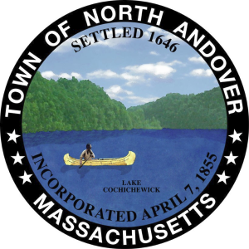
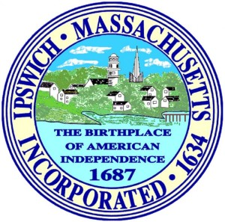
PIE-Rivers is . . . You!

Slide 5
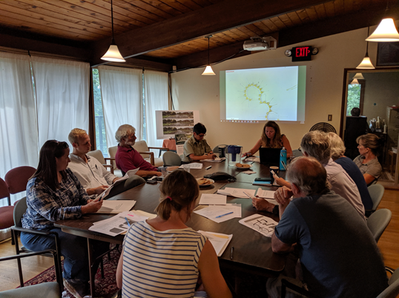
Current Structure
Steering Committee
Amy Weidensaul (Mass Audubon)
George Comiskey (Parker River Clean Water Association)
Heidi Gaffney (Town of Topsfield)
Jennifer Hughes (Merrimac Valley Planning Commission)
Kaitlyn Shaw (Ipswich River Watershed Association)
Kate Bowditch (Essex County Greenbelt)
Michelle Craddock (MA Division of Ecological Restoration)
Kathryn Glenn (MA Office of Coastal Zone Management)
Kristen Grubbs (Town of Ipswich)
Nancy Pau-interim (Parker River National Wildlife Refuge)
Peter Phippen (Eight Towns and the Great Marsh/
Merrimack Valley Planning Commission)
Robert Bauchsbaum (PIE-LTER)
Ross Povenmire (Town of Boxford)
Sam Cleaves (Metropolitan Area Planning Council)
Partners
Sub-Committees
Town Reps Program
Restoration Progress
Notes:
Please reach out to Brian if interested in joining a committee

Slide 6
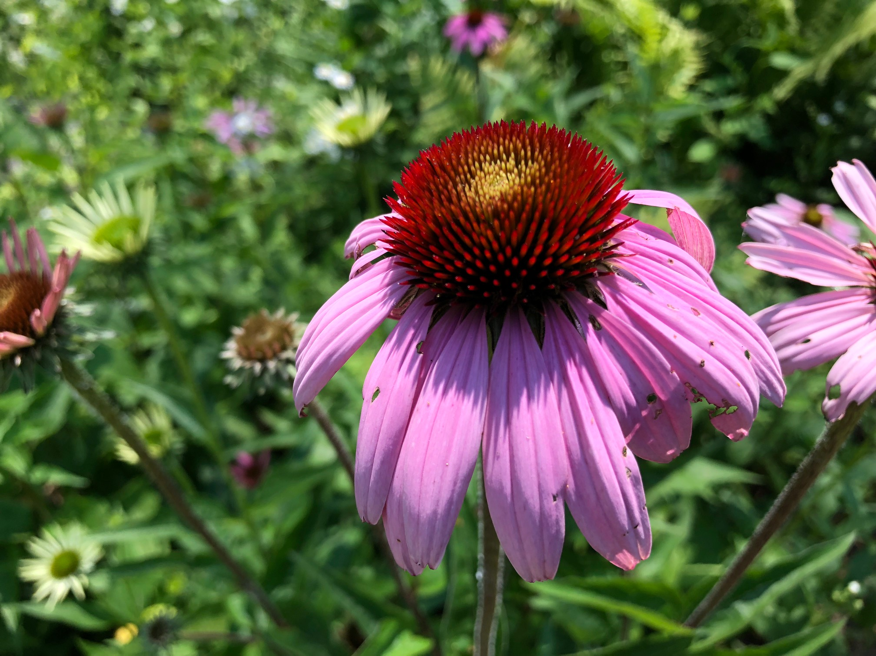
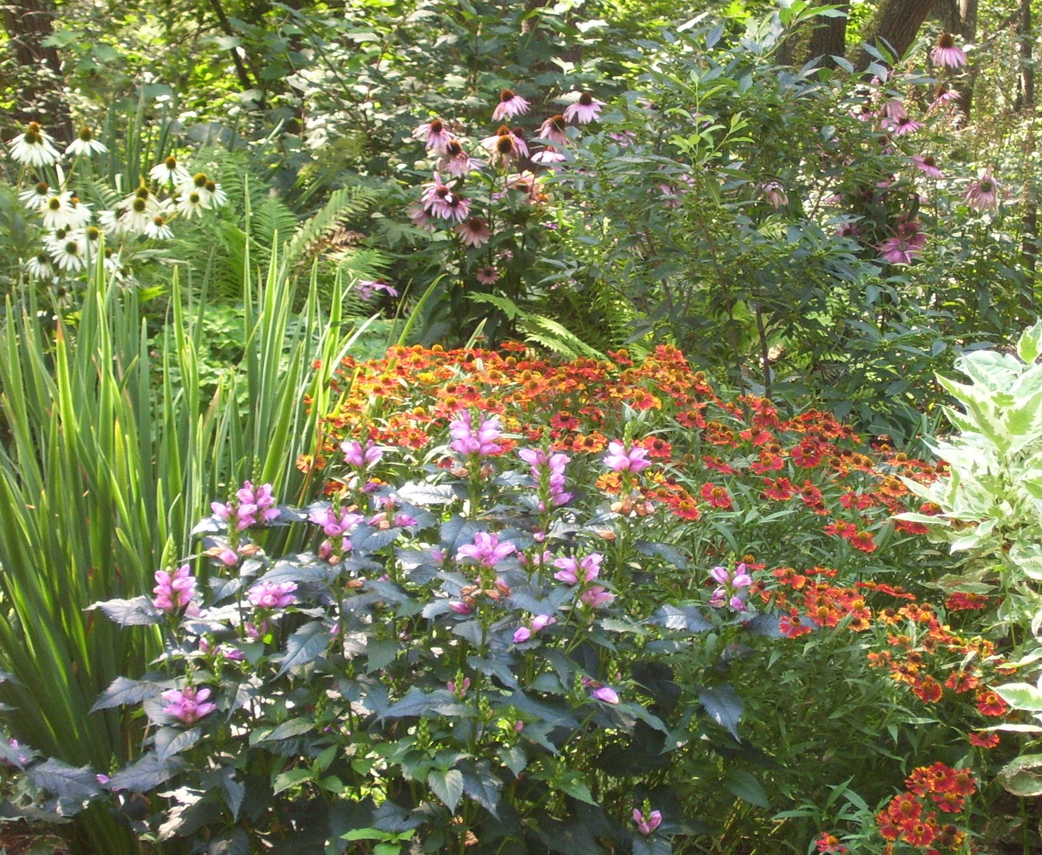
Business Meeting Agenda
Strategic Planning Update
2019 Year in Review
Town Reps- Overview & Welcome

Slide 7
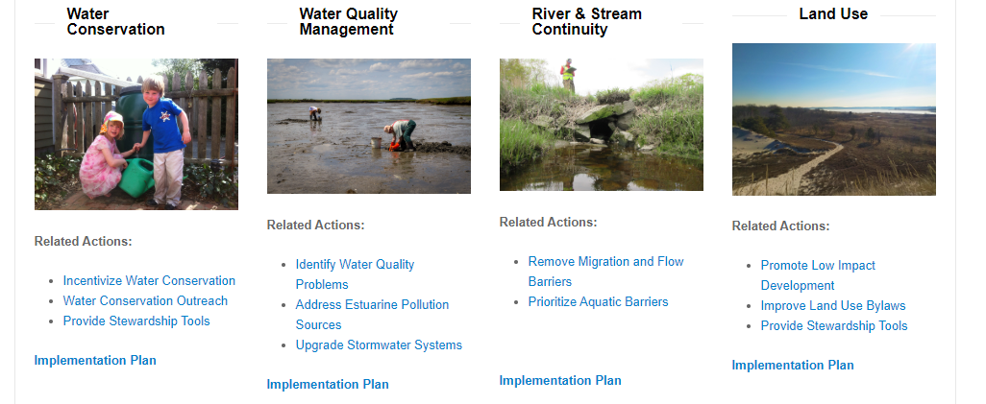
Business Meeting
1. Strategic Planning Complete- thanks to ECCF and NEBF funding.
2. Updated Restoration Priorities for the Parker, Ipswich & Essex River Watersheds Action Plan- June 2019.
3. Developed 3-year implementation plans for 4 priority actions.
4. Merged Municipal Committee with Steering Committee and developed Town Reps program to ensure Municipal needs are being met.

Slide 8
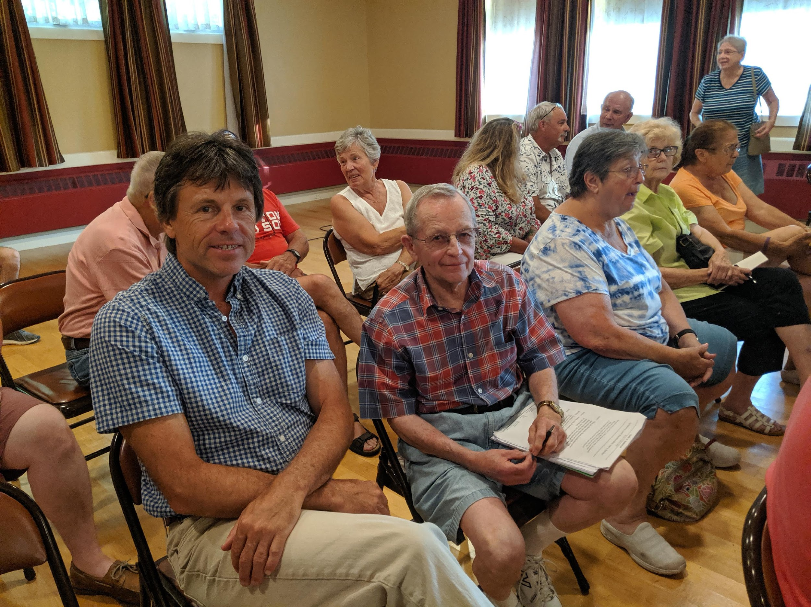
Town Representative Program
Town Reps agree to be a liaison between the town or city and the Partnership. Create a network to find mutually beneficial solutions to address water-related issues.
General understanding of the goals of the PIE-Rivers Partnership.
Being a liaison for PIE-Rivers projects and priorities in your local community, as needed.
Following the agendas of your community’s governmental meetings and other town happenings. Alerting PIE-Rivers staff or Partners to items related to PIE-Rivers priorities.
Supporting & attending the PIE-Rivers Partnership’s Annual Meeting, inviting your community, suggesting agenda items or presentation topics.

Slide 9
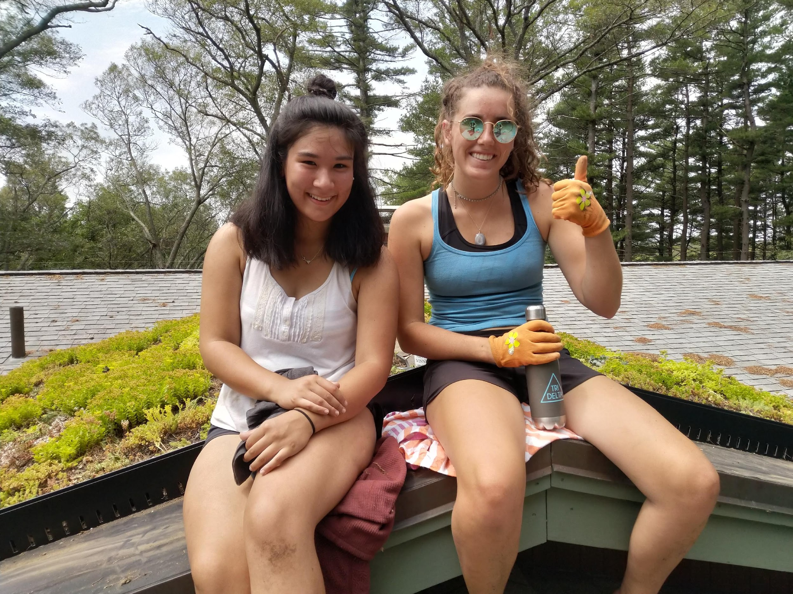
Thank you for attending the 6th Annual PIE Rivers Partnership Annual Meeting! Partner & Community Updates Stay tuned for: Implementation plan next steps Town Reps Engagement Activities

